Slide 1
Waterman and MHA PSP3
Continuing and developing our partnership

Slide 2
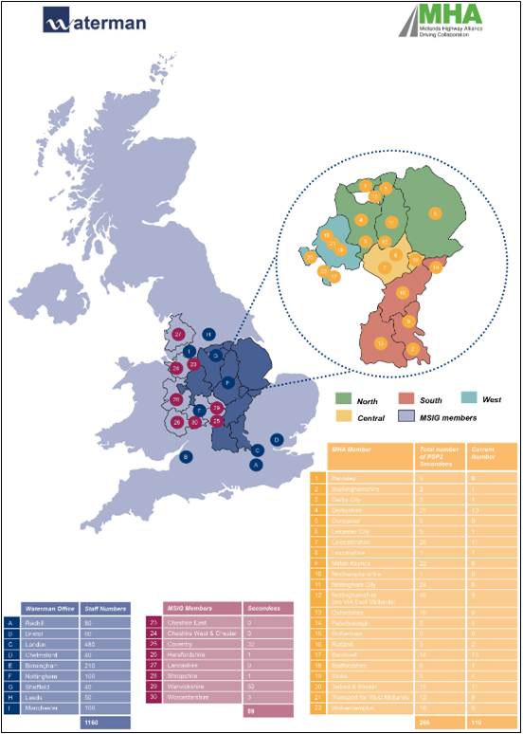
OFFICE STRUCTURE AND CURRENT SECONDMENTS
We have delivered secondment support to MHA clients since the original 3CAP framework in 2007.
We currently have 534 technical staff, including 61 managers on secondment
We currently supply 120 secondees to MHA members & 89 to MSIG members.
Many of our staff have been seconded to MHA clients for a number of years
Waterman also provide full teams.
Secondments have same controls as small projects with defined scopes.
With our salaried employees the risk of IR35 non-compliance disappears

Slide 3
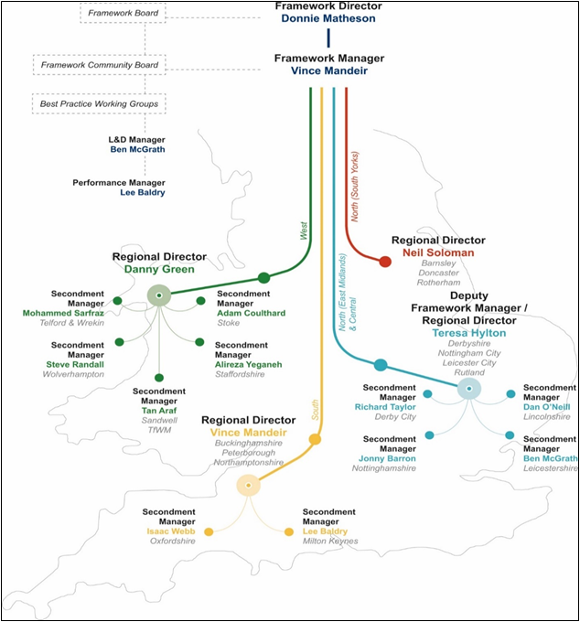
OUR DELIVERY MODEL
Each member of our delivery team has experience working for local authorities
Our embedded Secondment Managers will be the first point of contact for Client Managers, discussing current requirements and future needs.
Performance Manager, Lee Baldry, will drive continuous improvement through new Secondment Performance Indicators
Our L&D Team will provide mentoring for MHA staff and access to Champions
Teresa Hylton, will also head up a Social Value Leadership Team.
Our online timesheet system is managed by our Business Support Director.
Additional support provided by our HR Director and admin team

Slide 4
PART 2: FRAMEWORK INFORMATION 7.3 LOT 2
7.3.1 There are two possible procedures:- 1) direct call off based on the overall outcome of the tender process, 2) mini competition. It is for the Client to determine which is the best option.
7.3.2 Direct call off – the Client may award Time Charge or Work Orders directly to the Supplier with the most economic advantageous offer over the whole MHA region in the PSP3 tender process
7.3.3 Mini competition - The Client will determine the criteria (quality and price) that will be used to identify the most economically advantageous offer, and how that will be evaluated. The Client will inform the Suppliers in writing of these criteria.
7.3.4 The Client will obtain quotations from both Suppliers in accordance with the Quotation Procedure.
7.3.5 The Client will consider the quotations received, evaluating and calculating the quality criteria as stated in evaluating the total of the quotation.
7.3.6 The Supplier with the highest aggregate score (i.e. for price and quality) will be issued with an Instruction to carry out the Work or Time Charge Order.

