Slide 1
Amey Consulting
Our thinking is cutting edge. Our approach is practical.

Slide 2
A lot to be proud of
Nearly
100
years of experience
Revenue of
£267m
Proud to win over
20
awards since 2015
A team of
3,000
talented colleagues
Nearly
150
new recruits this year
A reassuring
100+
areas of technical specialism

Slide 3
Our Evolution
Founded by William Amey
Acquired by Ferrovial
Acquired TPI, WYG Rail and Donarbon
Amey
Consulting
launched
Acquired Enterprise
1921
2002
2003
2006
2009
2010
2011
2012
2013
2014
2017
Acquired Owen Williams
ACE/NCE Consultant of the Year
IiP Gold and Champion status
RoSPA Gold award

Slide 4
MHA PSP3
Our Approach and your Amey Consulting team

Slide 5
Our Approach to MHA PSP3

Slide 6
Our MHA PSP3 Framework Team
Andrew Yeoman
Framework Director
Katie Burnell
Framework Manager
Chris Barker
Sub Region 1
Regional Delivery Manager
Murray Seddon
Sub Region 2
Regional Delivery Manager
Darran Griffiths
Sub Region 3
Regional Delivery Manager
Andy Hieron
Sub Region 4
Regional Delivery Manager
Technical Support
Technical Directors

Slide 7
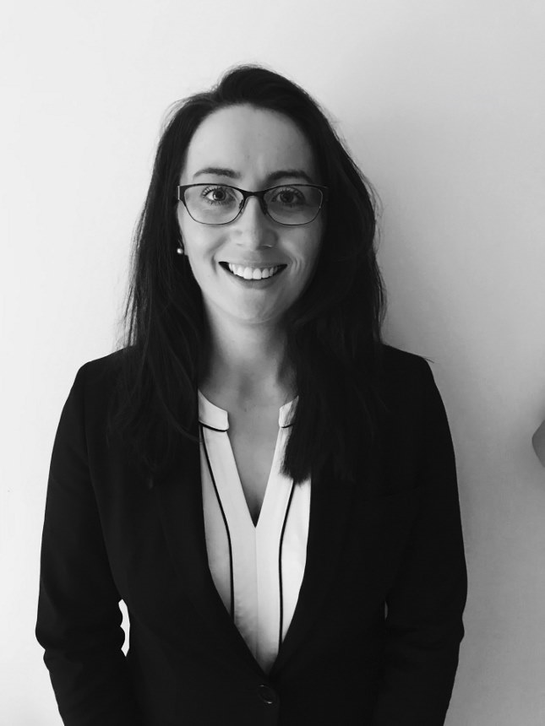
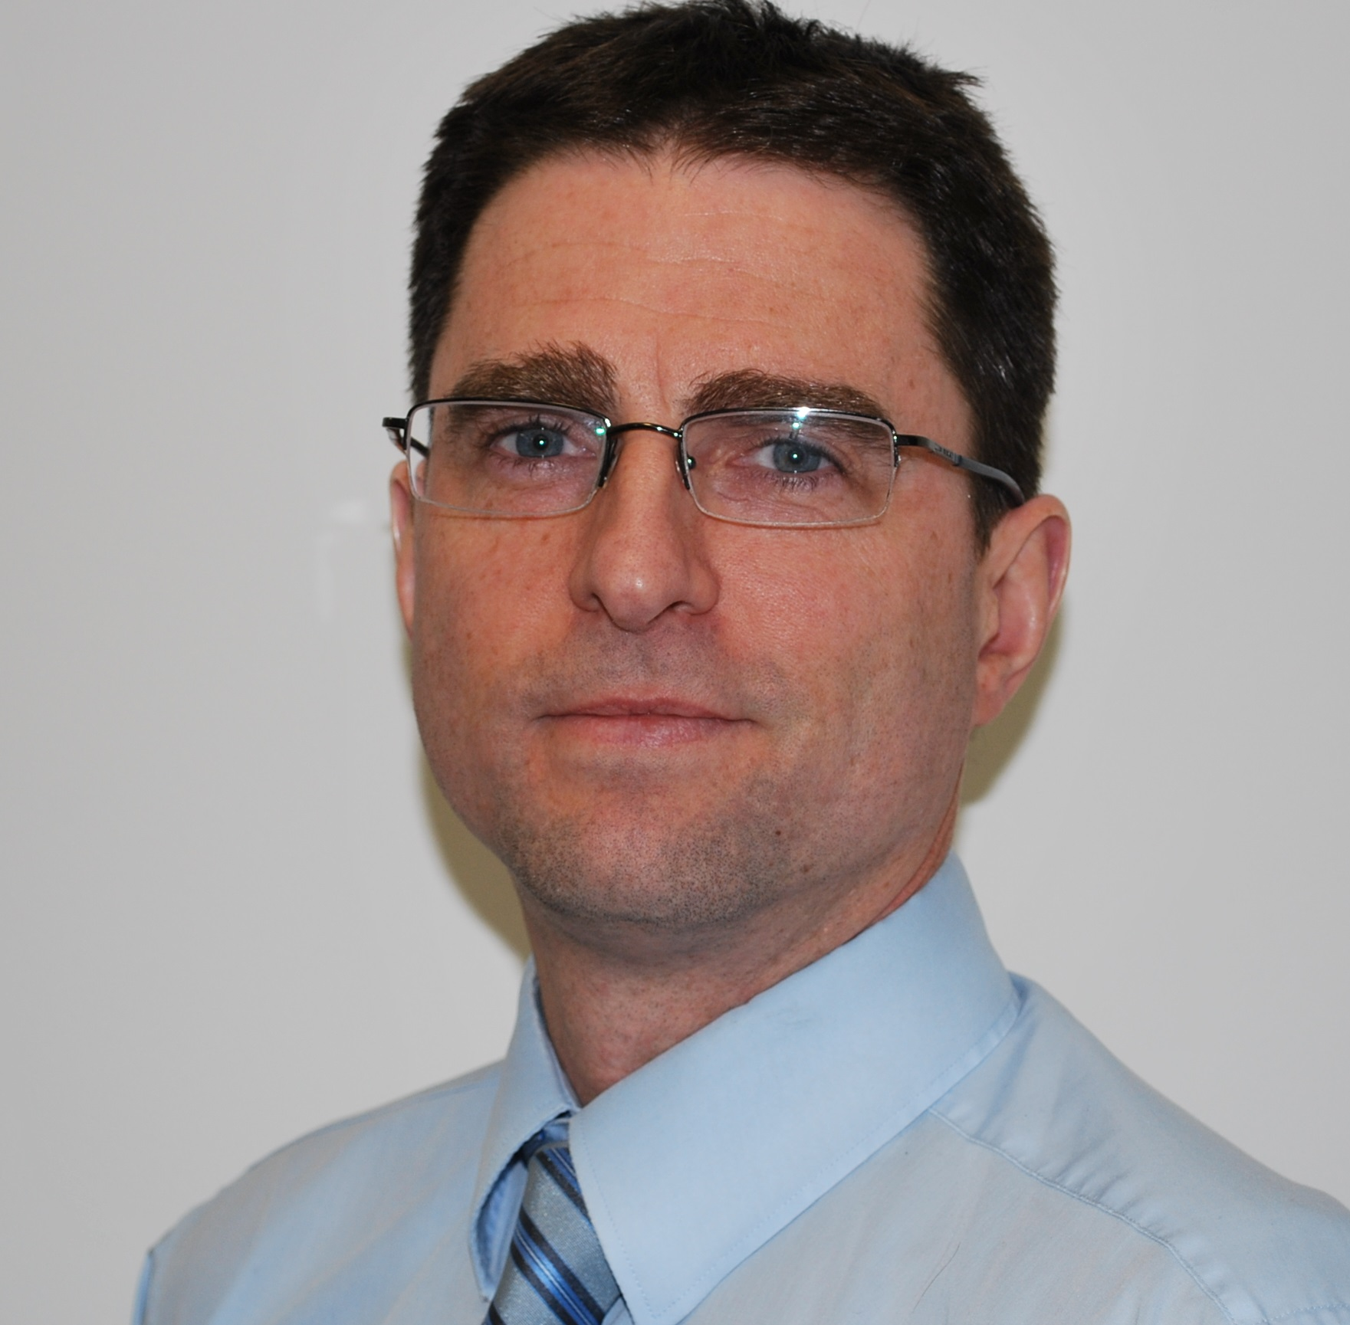
Sub Region
Murray Seddon
Delivery Manager Sub Region 2
Derbyshire County Council
Nottinghamshire CC
Nottingham City Council
Barnsley MDC
Derby City Council
Doncaster MBC
Lincolnshire County Council
Rotherham MDC
Andrew Yeoman
Framework Director
Katie Burnell
Framework Manager

Slide 8
Our Local Offices
We have 370 Highway and Structures Engineers locally based across 4 offices, ready to support
Office | Engineers
Birmingham | 168
Sheffield | 87
Stafford | 73
Gloucester | 42
Notes:
We recognise that sometimes demand or technical capabilities sometimes outstrip our resources, even after we have reached back into our wider business. That's why as part of this Framework we have added Arup and its considerable midlands resource pool to our supply chain should we need it. This approach provides members with a reassurance that we will be able to deliver their requirements

Slide 9
Contact Us
Via Email – click here
Or via phone
Murray Seddon - Sub Region 2 Delivery Manager - 0772 544 5484
Katie Burnell - Framework Manager - 07725 445 726
Andrew Yeoman - Framework Director - 07834 254 385

