Slide 1
Matchtech - PSP3 Lot 2
Secondment Partners
June 2019
Global engineering recruitment specialist

Slide 2
Introduction to Matchtech
Founded in 1984
Technical resourcing specialists, focusing on Engineering markets
20 years’ experience in the Public Sector market
Highways, Traffic, Transport Planning, Structures, Project Management, Maintenance, Town Planning & Building Control
Offices in Southampton and Derby, but cover the whole of the UK with over 250 current secondees out on assignment

Slide 3
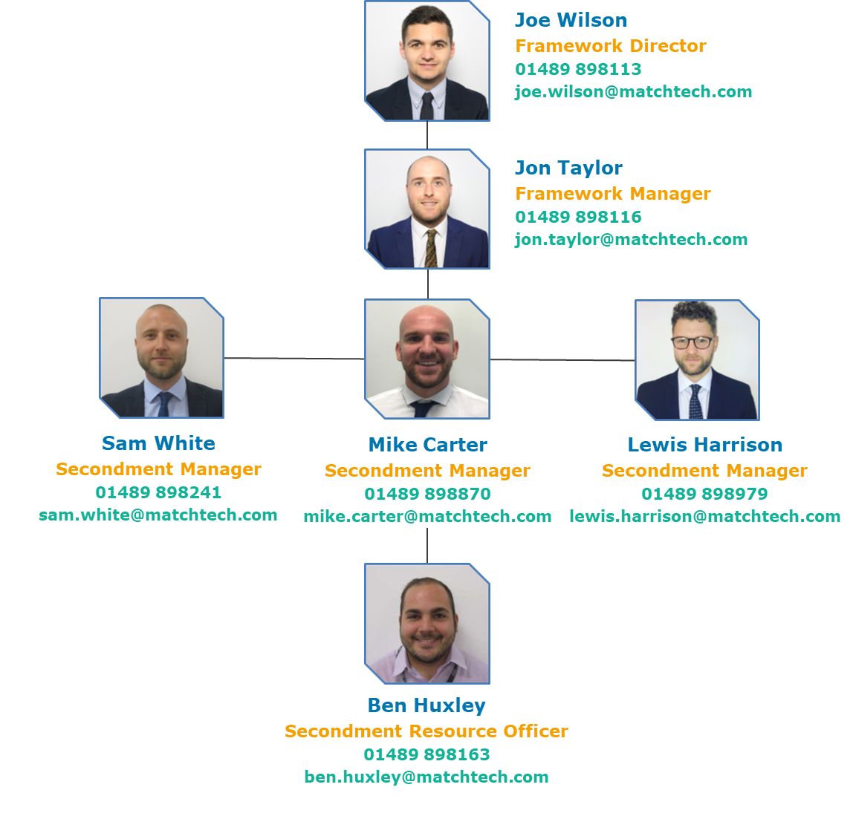
Introduction to the team
Our PSP3 Team has over 32 years’ combined experience, and is shown to the left.

Slide 4
Thank you
Really thrilled to support your projects and secondment opportunities
The next four years are exciting for the Highways industry
Working collaboratively with Watermans on Lot 2 Secondments
Our services can be reached via the Mini Competition route
For any further information, please email mha@matchtech.com or contact any of our Secondment Managers directly

