Slide 1
2017 MHA Annual Event - Celebrations and Aspirations
Effectiveness of NACF Frameworks
Keith Heard
Senior Programme Manager Hampshire County Council
Framework Manager SCF
Chair NACF

Slide 2
Why is wrong with traditional tender?
Disputes
Scope
Quality
Extras
Cost predictability

Slide 3
How do people view frameworks?
It’s someone else’s - I can do better
I can do better by tendering
There is no competition
Lazy contractors
Avoids OJEU

Slide 4
What is a framework?
A long term relationship with a reduced number of suppliers
A vehicle for learning and improvement
Joint commitment to long term goals

Slide 5
A brief history
2006
2009
2010
2011
2012
2013
2014
2015 2016
First Regional Framework
RIEP’s
Government Construction Strategy
LGA National Construction Category Strategy
NIEP established
Construction 2025
Government Construction Strategy 2016 - 2020
Task Group reports
NACF founded

Slide 6
NACF Framework Evolution
5?
Supply Chain engagement?
Market the industry to young people?
More?
4
Wider offer
Aligned to Government strategy
Responds to local and central needs
Improvements added with each new generation
3
Social benefits
Managed collaborative service
Supply Chain engagement
2
Improved delivery
KPI’s to show success
1
Avoids OJEU

Slide 7
Effective NACF Frameworks
Have a demonstrable business need
Have clearly defined objectives
Understand the market
Have good governance and management
Have a strategy for the supply chain, SME’s and localism
Strive to continuously improve
Provide a vehicle for best practice

Slide 8
An effective framework is one that…….
Actively engages
Is actively managed
Maintains competitive tension
Provides sufficient work
Measures performance against required outcomes
Can demonstrate value
Provides jobs and skills, local employment and engages SMEs

Slide 9
The benefits can include………
Savings in cost and time
Reduction in disputes
High client satisfaction rates;
High proportion of work by SMEs;
High proportion of local labour;
Implementation of local / national objectives
Less waste
Great Health and Safety

Slide 10
NACF KPI Review v. National Average
(Based on 600 projects with a construction value of £1.2bn)
Cost Predictability
Time Predictability
Percentage of projects delivered
to budget:
NACF 76% v. 64% National Average
Percentage of Construction Projects
delivered on time:
NACF 75% v. 55% National Average.
Fair Payments
NACF
KPIs
2016
Reportable Incidents
Percentage of payments made
within statutory compliance
timescales:
NACF 91% v. 79% National average.
98% of projects recorded with 0 reportable accidents
Client Satisfaction - defects
Client Satisfaction – product and service
Percentage of clients satisfied with the making
good of defects:
NACF 86% v. 73% National Average
Clients satisfaction scores of:
NACF 88% v. 85%/77% (respectively) National Average
Note - National figures derived from 2016 CITB UK industry performance report from Glenigan.

Slide 11
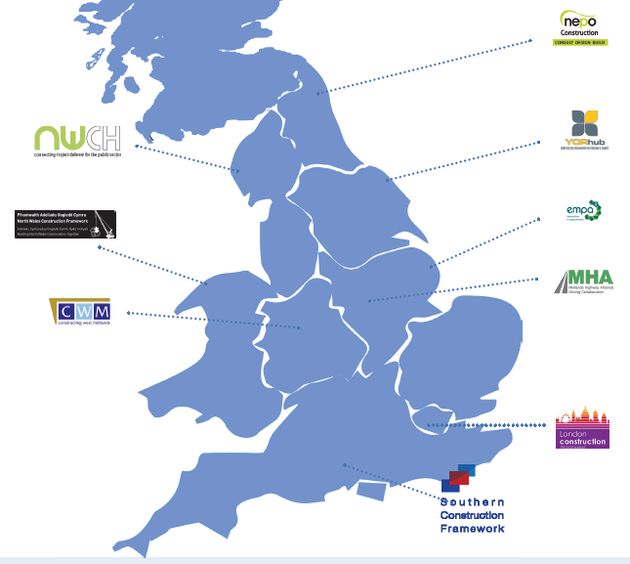
Our work includes
BIM
Performance
Social Value
Market intelligence
Innovation
Shared learning
Supply chain
Value
Integration
Pipeline
£1.4bn
annually
Notes:
This is who we all are.
Endorsed and recommended by EFA, and by Cabinet Office
Frameworks have become relationships with private sector
Making better use of private sector intelligence
Our intelligence and data are sought after by consultants, best accolade!!
And by the way, we deliver nearly one and a half billion of work a year. Using modern methods.

Slide 12
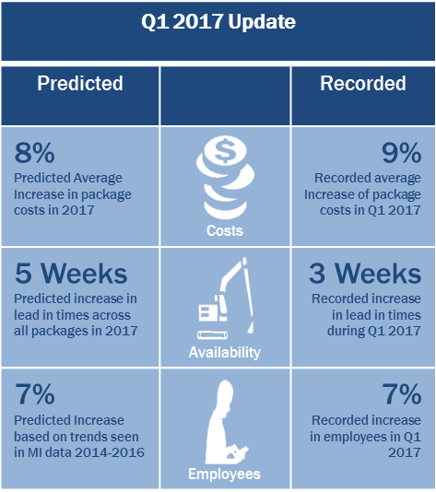
NACF Market Intelligence

Slide 13
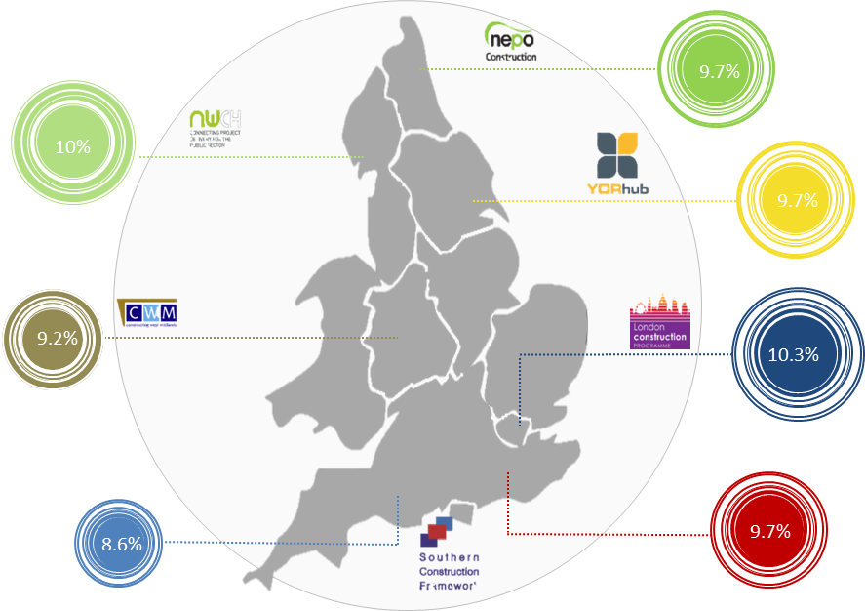
NACF Market Intelligence

Slide 14
Risks to effective frameworks
No demonstrable business need;
Not managed - merely a short cut to market
Advisors / consultants / Clients who promote lowest cost tendering.
Frameworks used to protect sovereignty and jobs
Less expert clients transferring risk

Slide 15
The future?
NACF continues to develop local government construction
New generations of frameworks building on success and learning
Pipeline and application of market intelligence
Changing success criteria
Building professional capacity in local and central government
Meeting local demands for social value
Demonstrating the practical benefits of integrated team working

Slide 16
Further information
www.nacframework.org.uk
www.gov.uk

