Slide 1


NEC – celebrate and aspire
Robert Gerrard

Slide 2
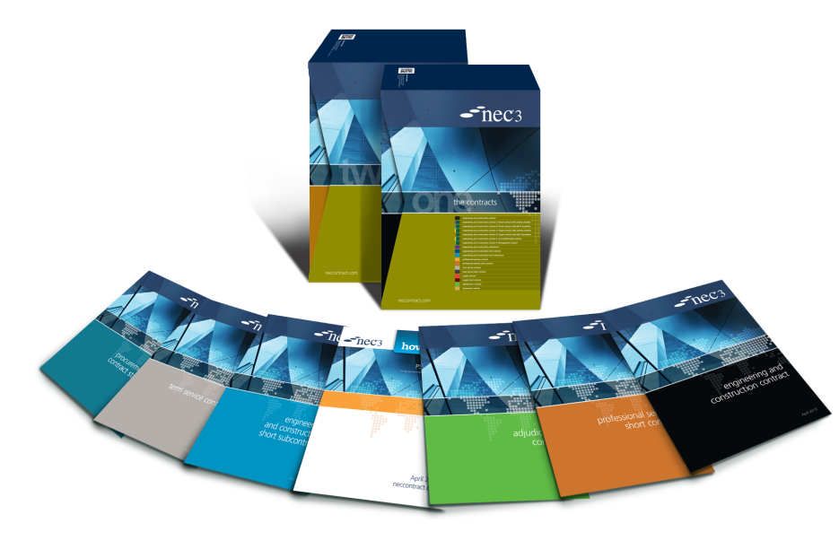

NEC – celebrate and aspire
A quick look back over MHA’s 10 year use of NEC3 (celebrate)
A quick look a the challenges ahead and using NEC4 (aspire)

Slide 3
Celebrate (MHA)
Safety
Savings
Outcomes
Disputes (lack of)
Culture
Training
Nominal Z clauses
But does the World know about this?

Slide 4
Celebrate (NEC3)
Projects
Outcomes
Disputes (lack of)
Culture
Accreditation
Users

Slide 5
Aspire
NEC4 launched June 2017
Extensive process to ‘consult’
Comes with recommendations
Significant press coverage
Lots of social media noise
Will clients migrate to NEC4?

Slide 6
Aspire
Main differences
  Consistency across NEC4 suite (Scope, Client, EWR, gender neutral)
  Contractor’s proposals (clause 16)
  Standard clauses now for assignment, disclosure, corruption etc
  Deemed Accepted Programmes (clause 31.3)
  Quality management (section 4)
  Application for payment now required (clause 50)
  Final assessment (clause 53)

Slide 7
Aspire
Main differences
  Client’s liabilities
  Dividing date (compensation events, clause 63.1)
  SCC/SSCC modified
  Finalise Defined Cost (clause 50.9)
  Changes to W1 & W2 – Senior Representatives
  New W3
  X21 Whole life cost
  X22 Early Contractor involvement

Slide 8
Aspire
What else?
  Incentives
    X6 bonus for early Completion
    X14 advanced payment to the Contractor
    X20 Key Performance Indicators
    Y(UK)1 Project Bank Account
  Collaboration
    X12 Multiparty collaboration
    Look at the ICES/RICS etc Conflict Avoidance Pledge

Slide 9

Questions?

Slide 10

Contact us
 +44 (0)20 7665 2446
 info@neccontract.com
One Great George Street, London SW1P 3AA
neccontract.com

