Slide 1
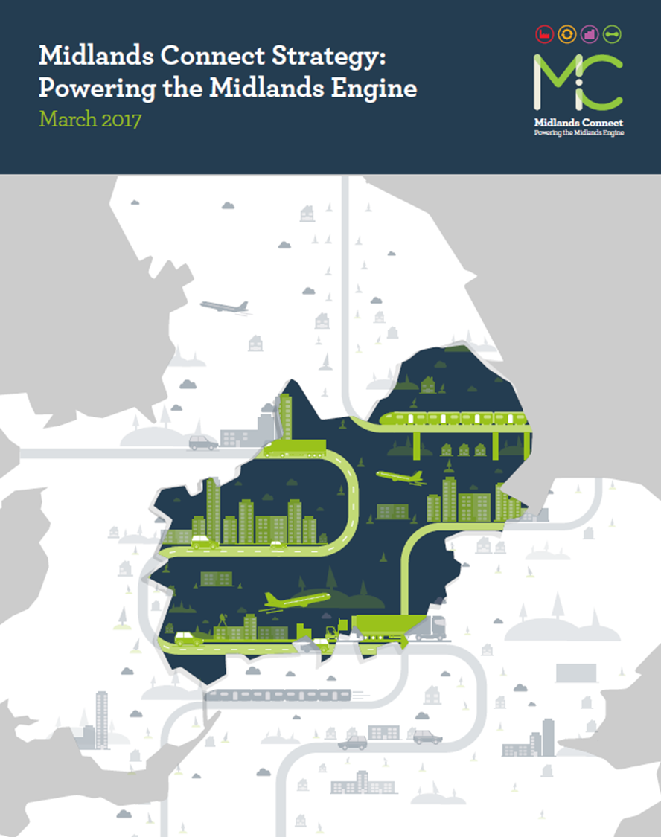
Midlands Connect: A Pan Midlands Strategic Transport Partnership

Slide 2
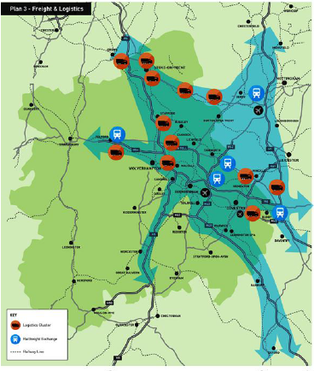
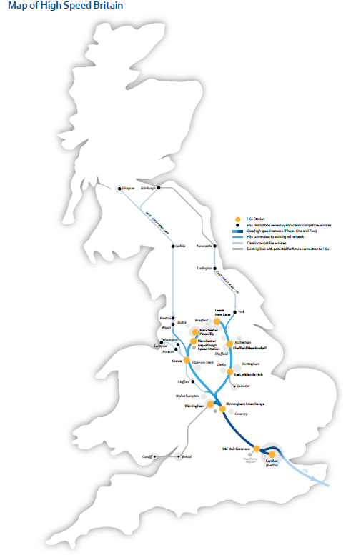
Where we came from

Slide 3
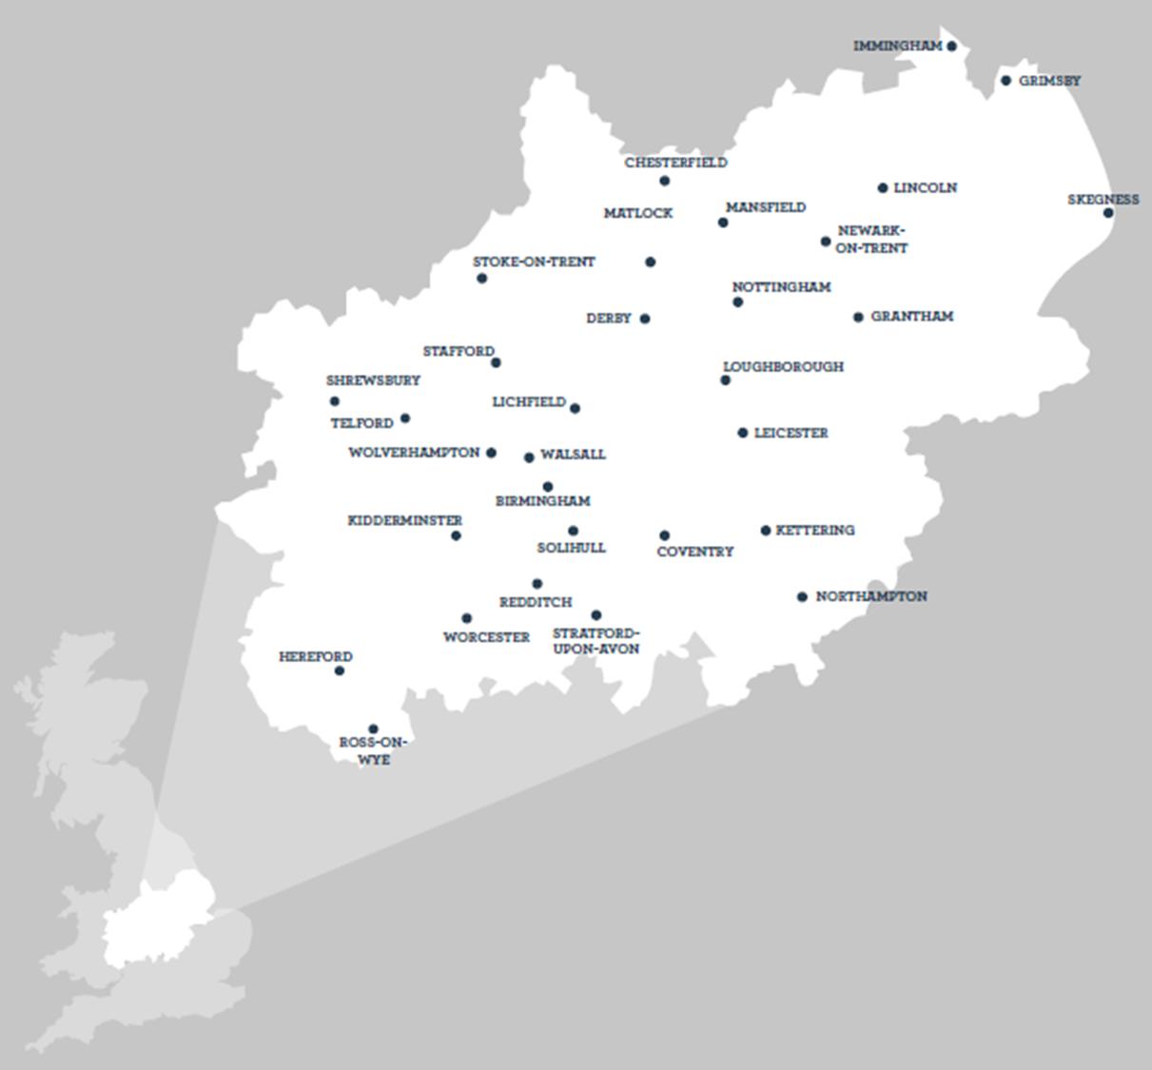
Our Partnership

Slide 4
The Journey…… so far

Slide 5
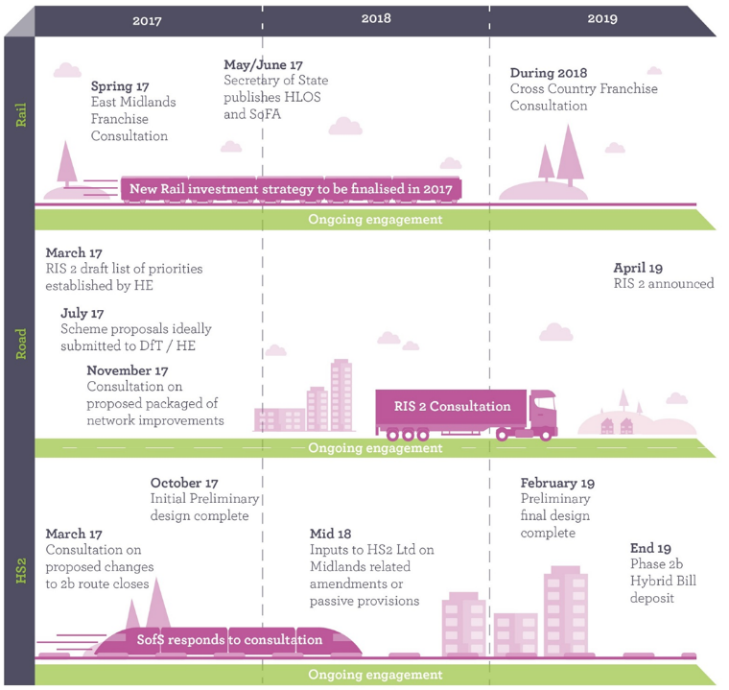
Now is the time to plan ahead

Slide 6
Midlands Connect: Our Transport Strategy

Slide 7
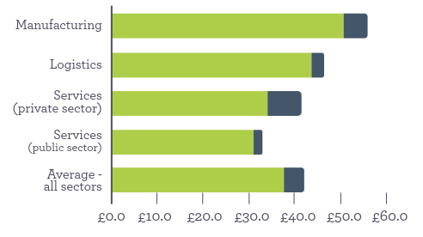
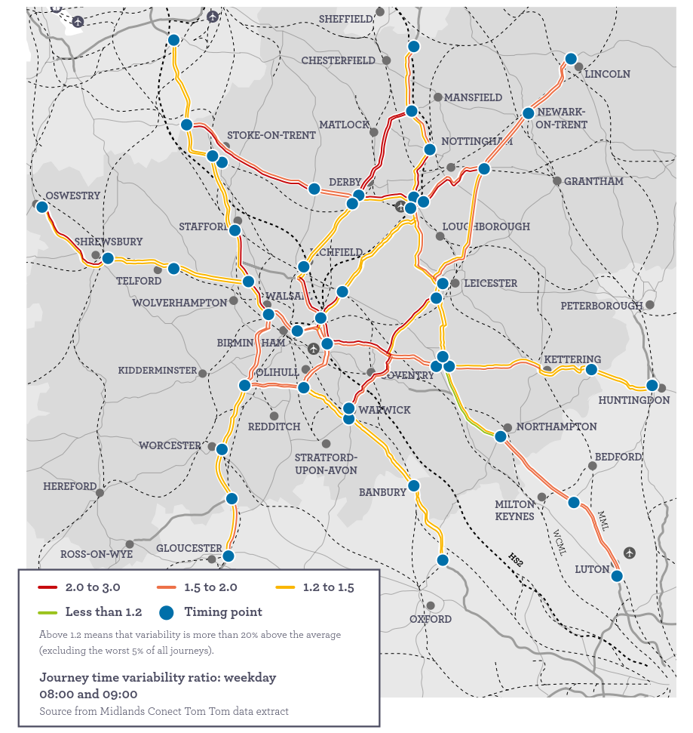
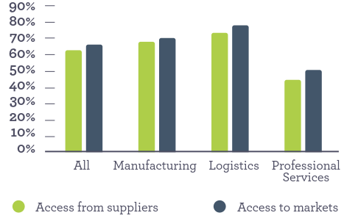
Evidence is our Strength
We understand our ‘problems’
We understand our economy

Slide 8
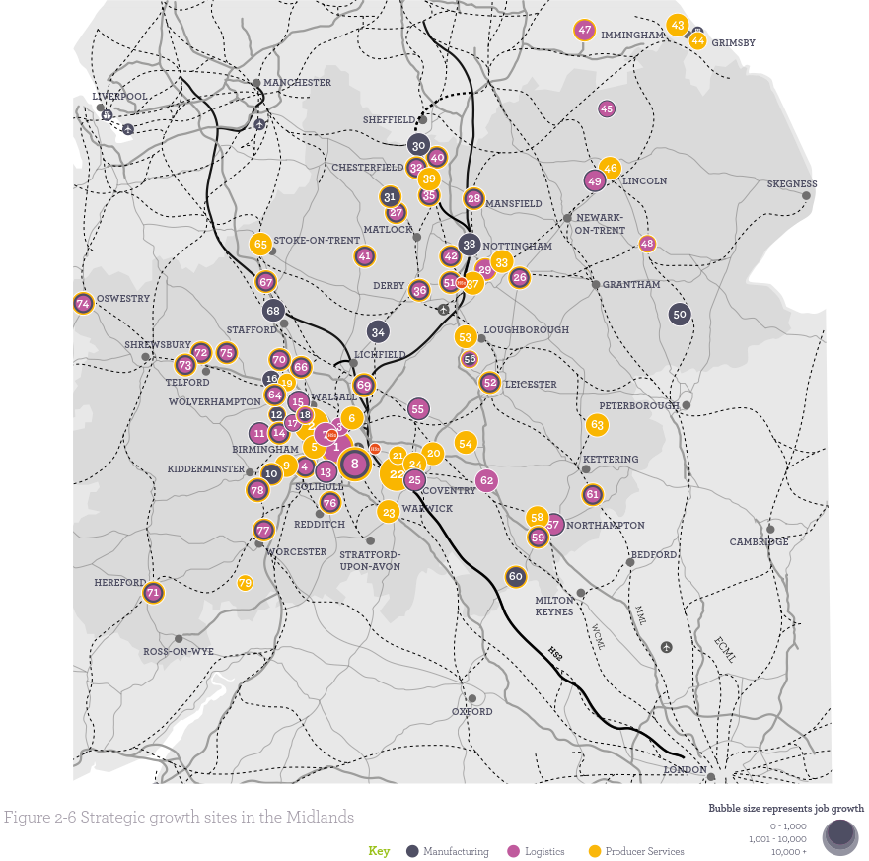
Evidence is our Strength
We understand our growth

Slide 9
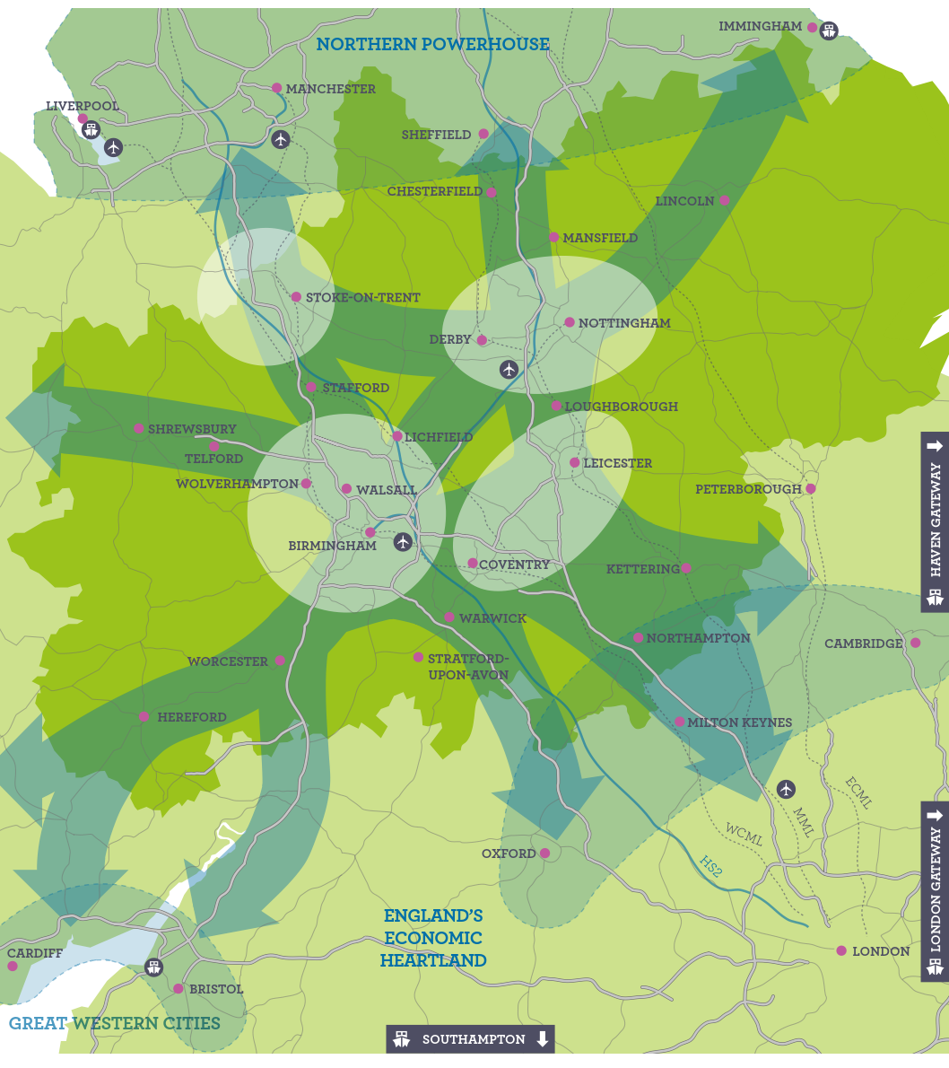
Evidence is our Strength
We understand our needs

Slide 10
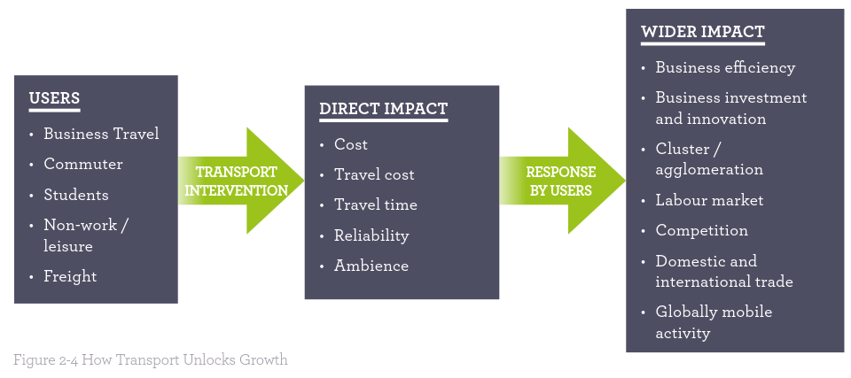
Evidence is our Strength
We understand how we can grow our economy

Slide 11
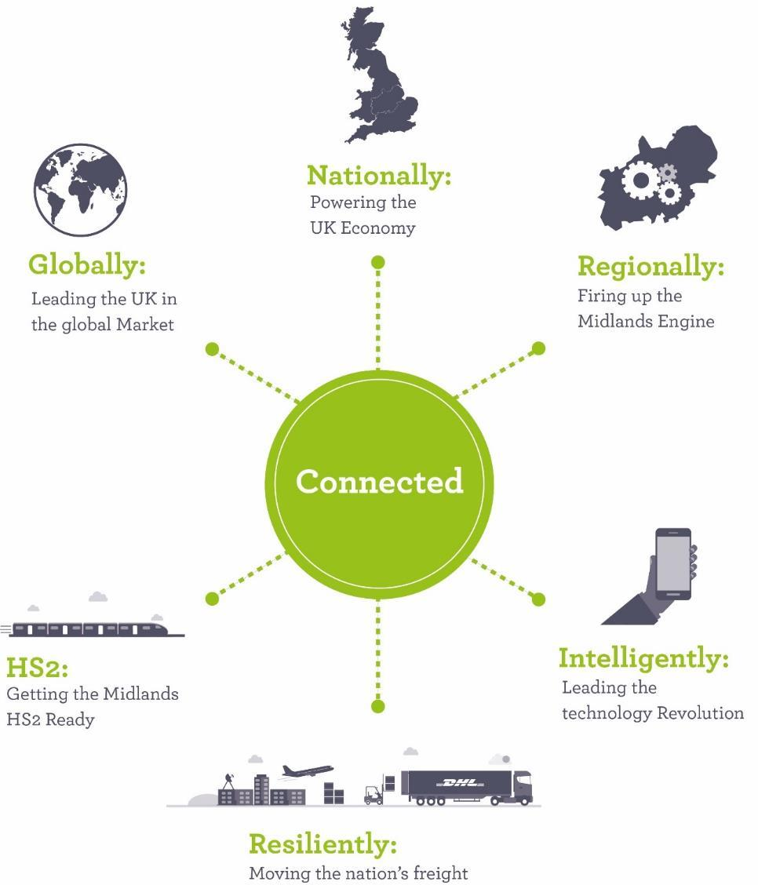
The outcomes that transformational connectivity will achieve

Slide 12
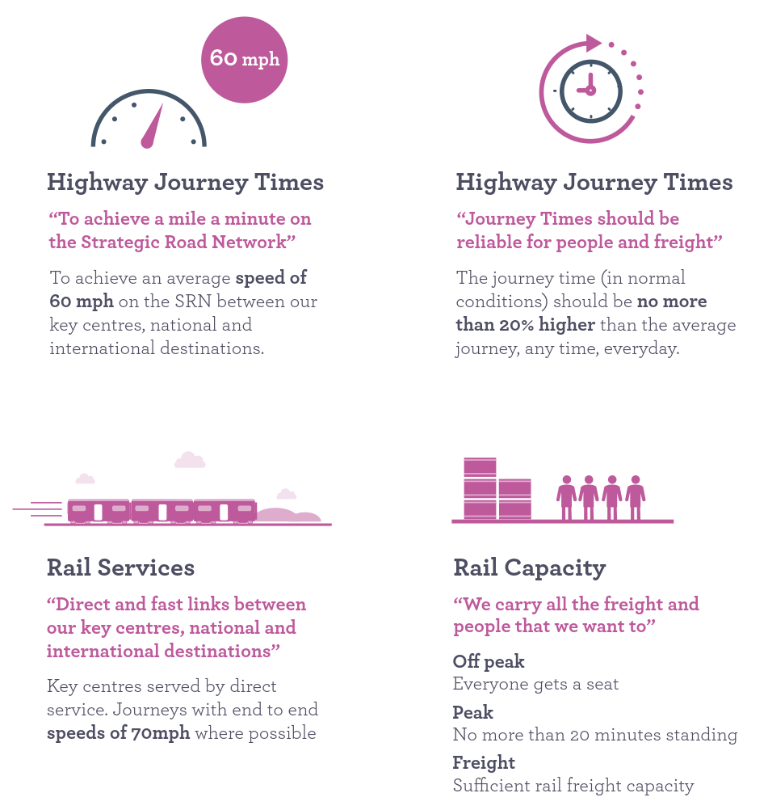
Our Ambition

Slide 13
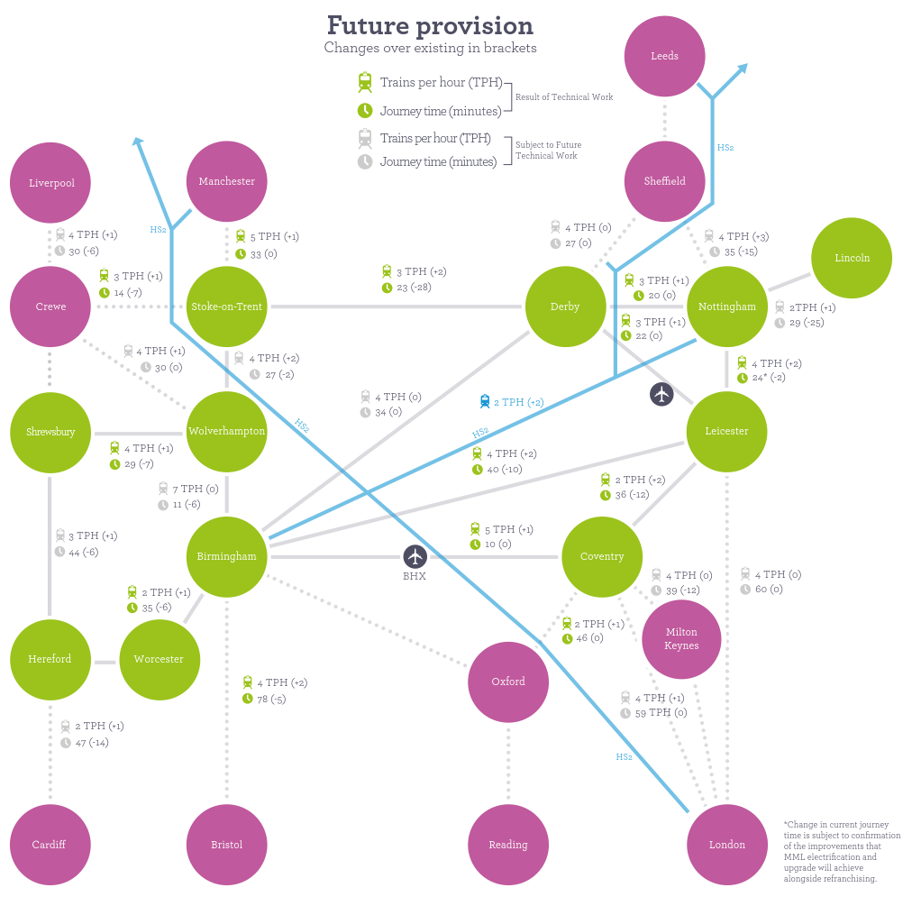
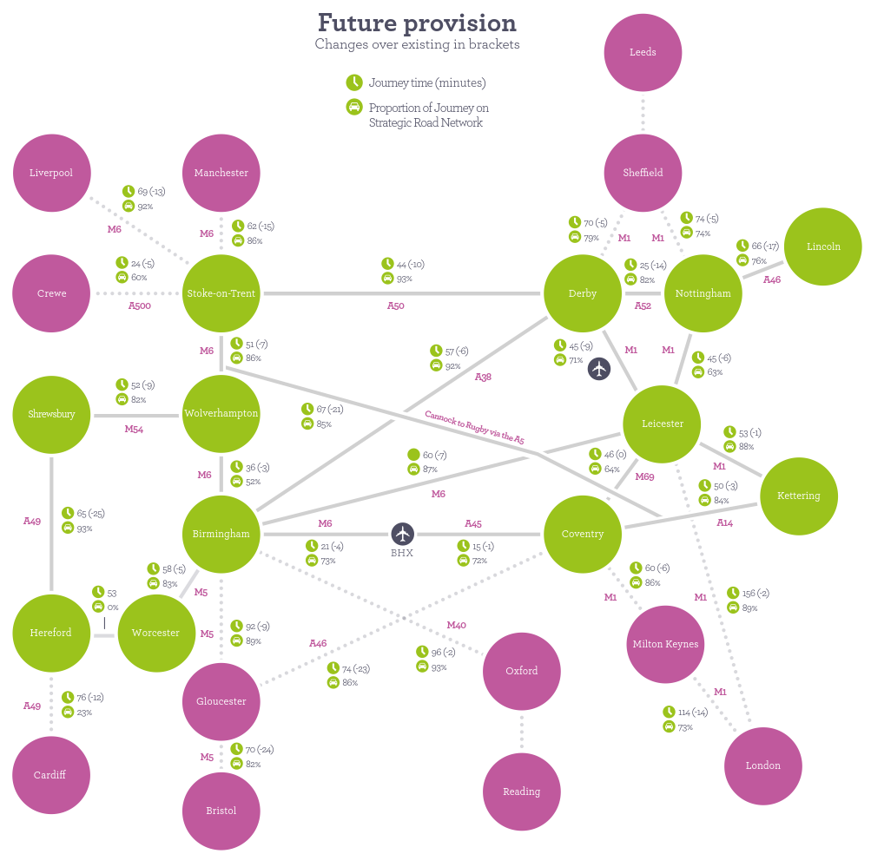
Our Ambition
Notes:
Take out replace with Our Ambition – Powering the Midlands Engine

Slide 14
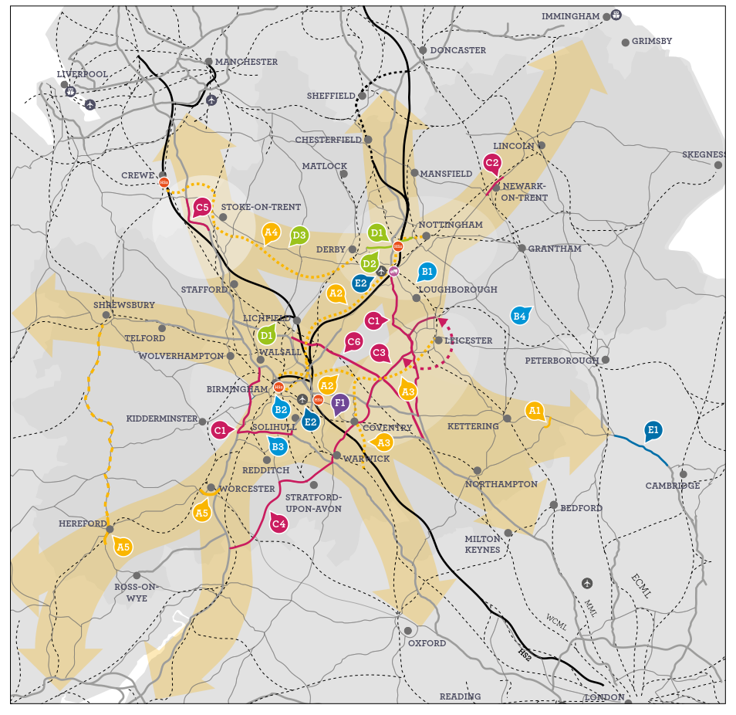
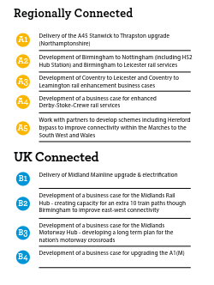
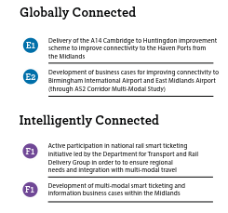
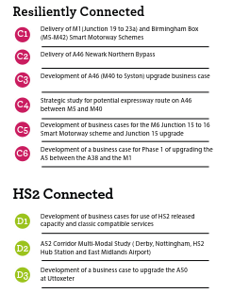
Clear Priorities for Action – Short Term
Our focus initially will be to:
Ensure commitments are delivered
Take forward early development
Demonstrate the case for schemes inclusion in investment programmes

Slide 15
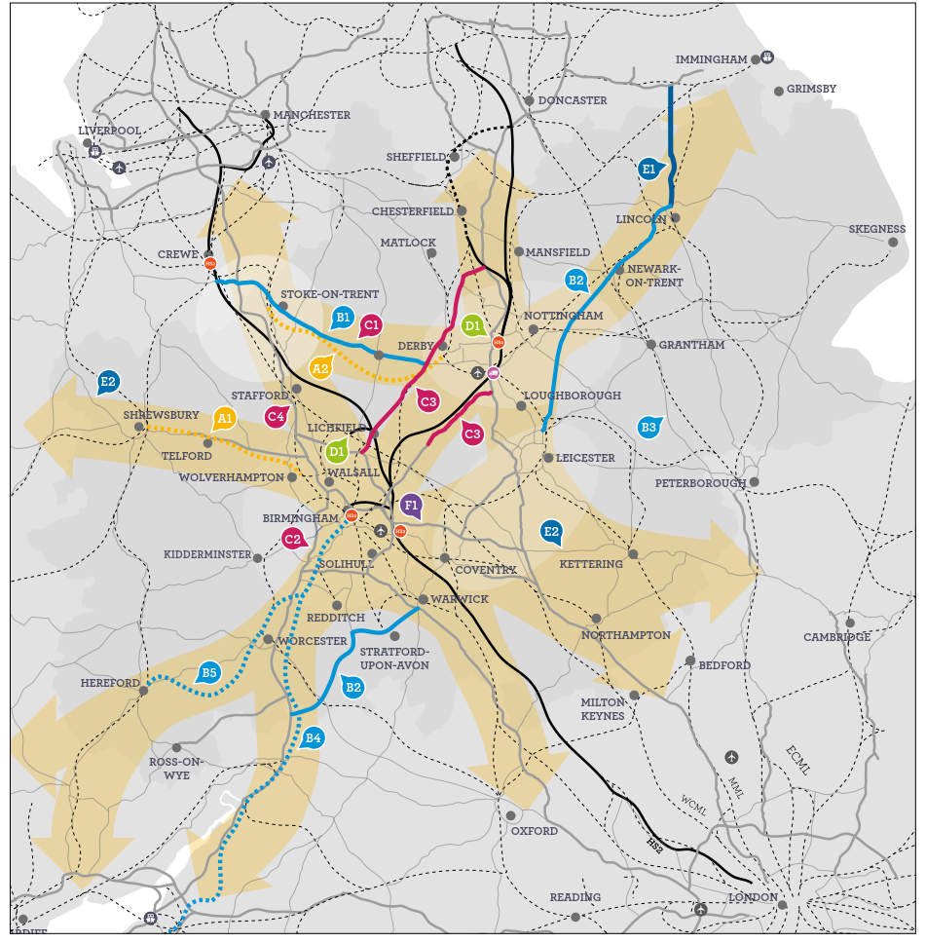
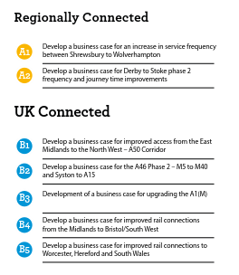
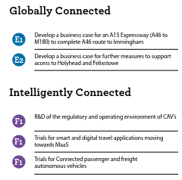
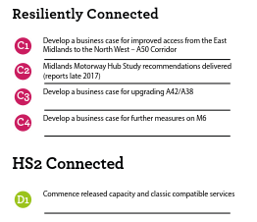
Clear Priorities for Action – Longer Term
Our focus will be:
Delivery of short term priorities
Rolling programme of development and business cases

Slide 16
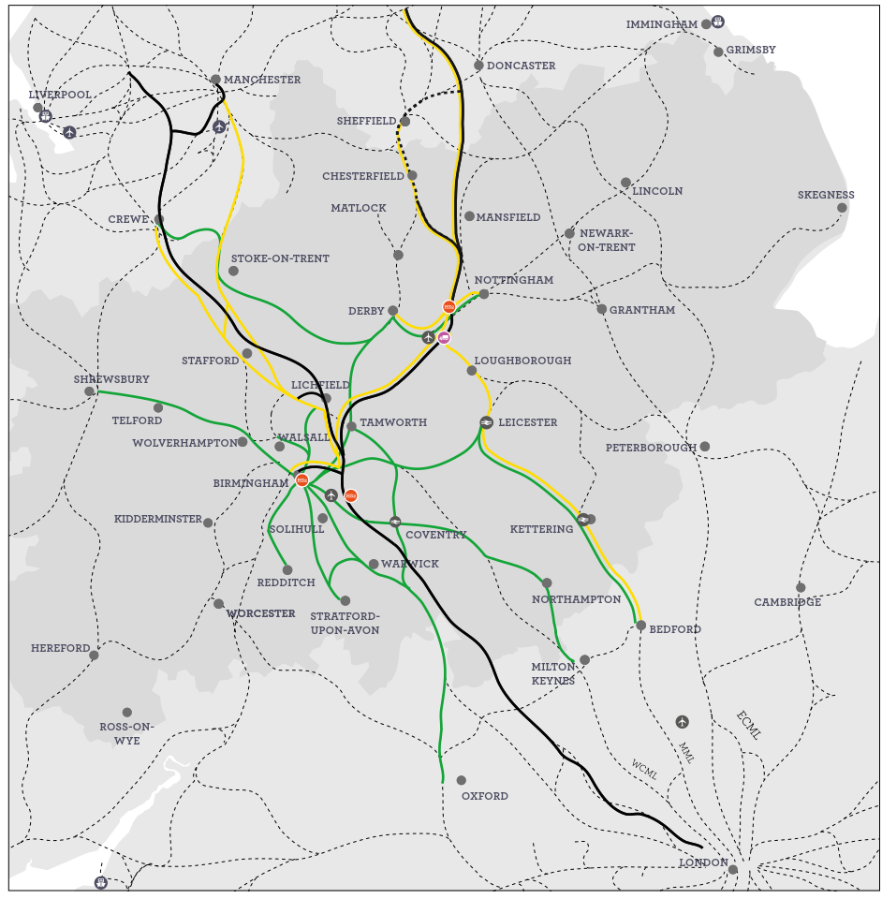
Taking Advantage of HS2
HS2 brings £2.6 to £5.3bn additional GVA to the Midlands in its own right.
We believe there are ways we can take further advantage of this nationally important infrastructure.

Slide 17
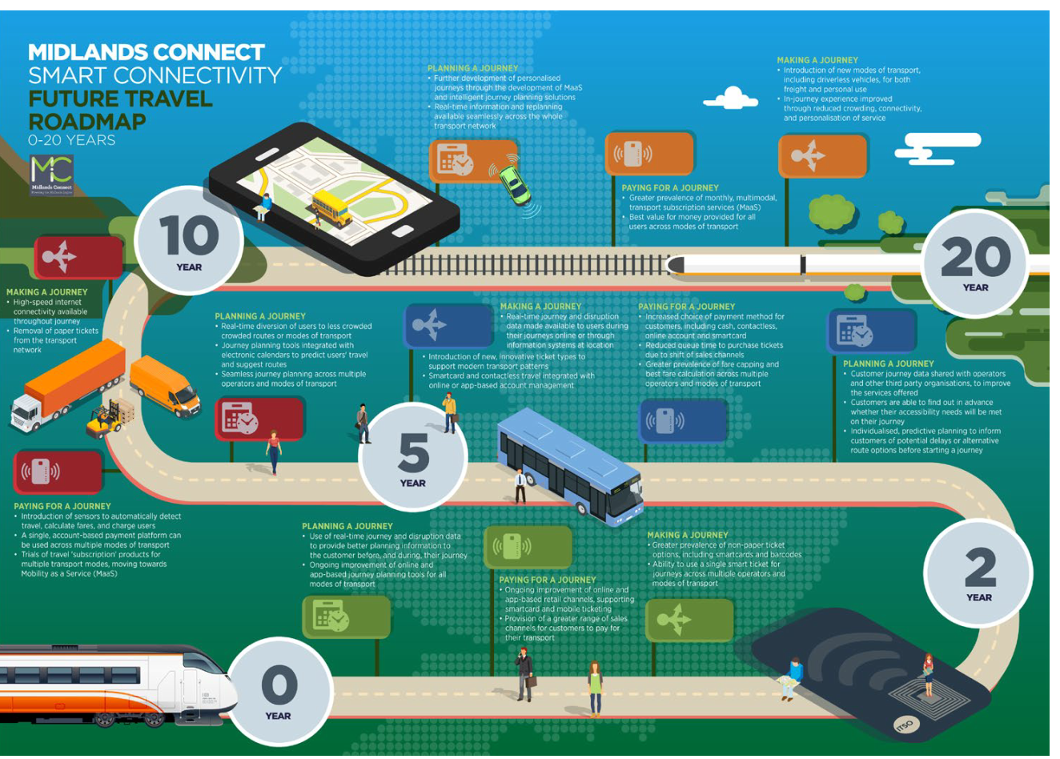
Smart and Digital Infrastructure
Our Role:
Fill the gap to develop and promote a regional, multi-modal smart ticketing strategy.
Coordination, facilitation and promotion across the region.
Understanding the links across programmes – e.g. the link between smart ticketing and information provision (Mobility as a Service)

Slide 18
Our Programme

Slide 19
MC Policy & Programme Development – 2017/2018
Road (working with HE toward RIS 2)
Midlands Motorway Hub
A46 Study
A49 Contributions
Major Route Network Study
Rail
Midlands Rail Hub
Pan Midlands Rail Corridors
HS2 Alignment Work
Road and Rail
East Midlands Gateways Connectivity Study
Smart Technology
Smart Ticketing
Autonomous Vehicles
Policy Work
Franchise Consultation
HS2 Phase 2b Consultation
Aviation and Freight

Slide 20
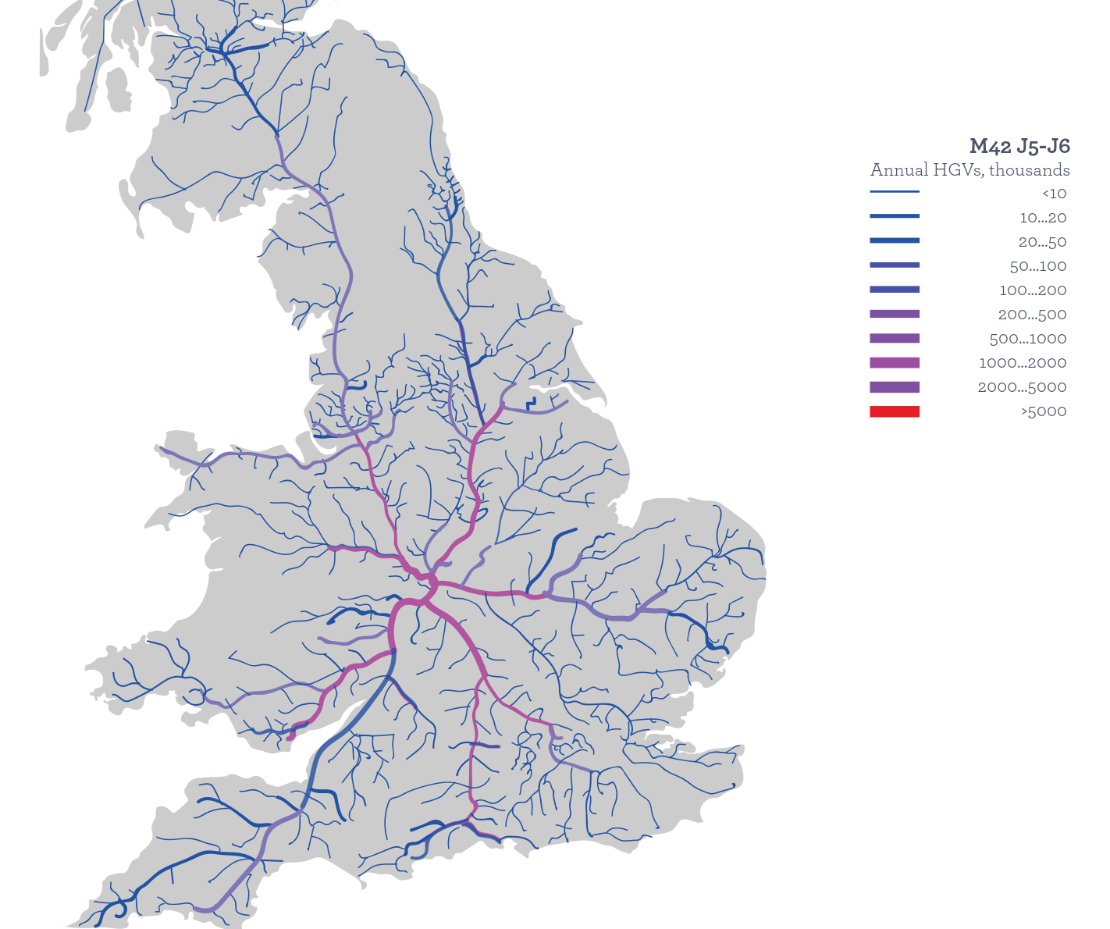
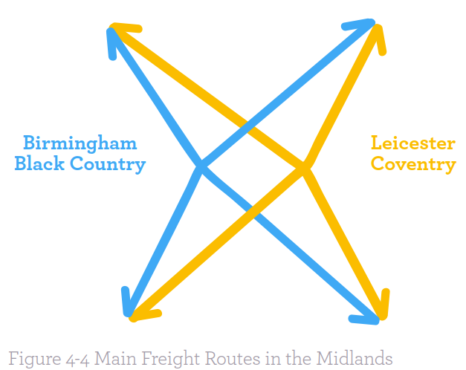
Midlands Motorway Hub
Highways England and Midlands Connect working jointly to deliver a study which will:
Assess and form a preliminary strategic case for improving the transport network in the region based on the strategic and economic benefits;
Identify a long-list of options which could meet the transport objectives, and undertake a high level assessment of the potential value for money, benefits and impacts of the different options;
Short-list the options to be carried forward at this stage; and
Prepare a Strategic Outline Business Case for the short-listed options for consideration in the development of future RIS.

Slide 21
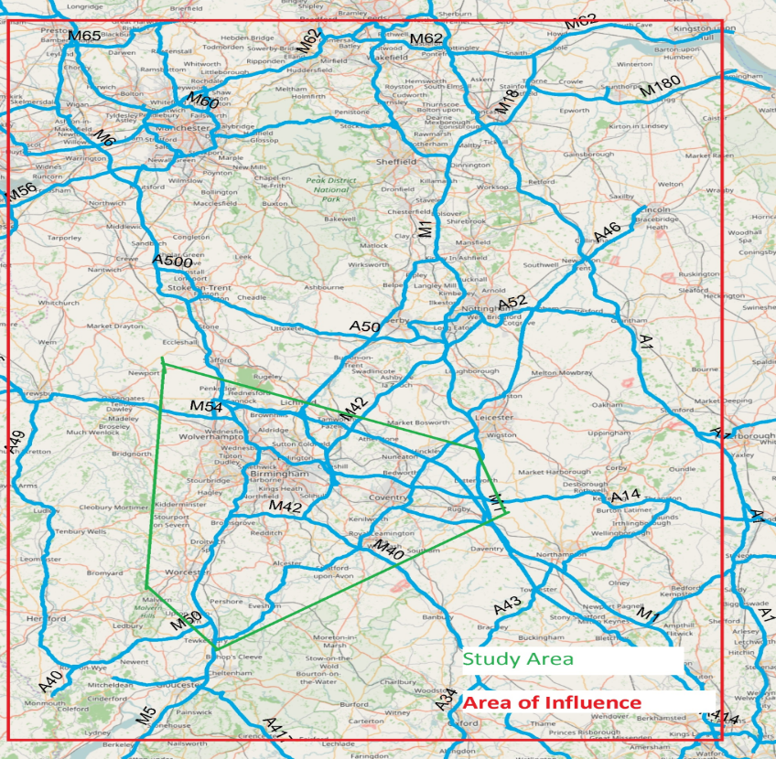
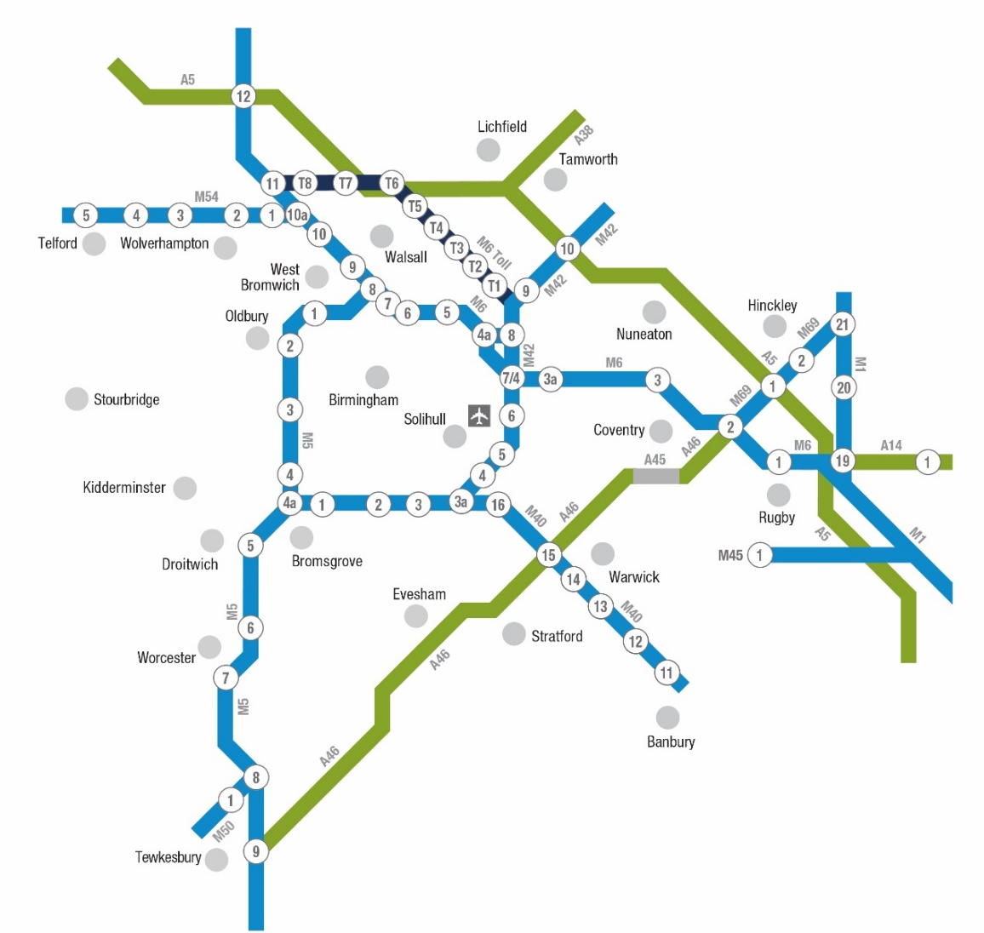
Midlands Motorway Hub

Slide 22
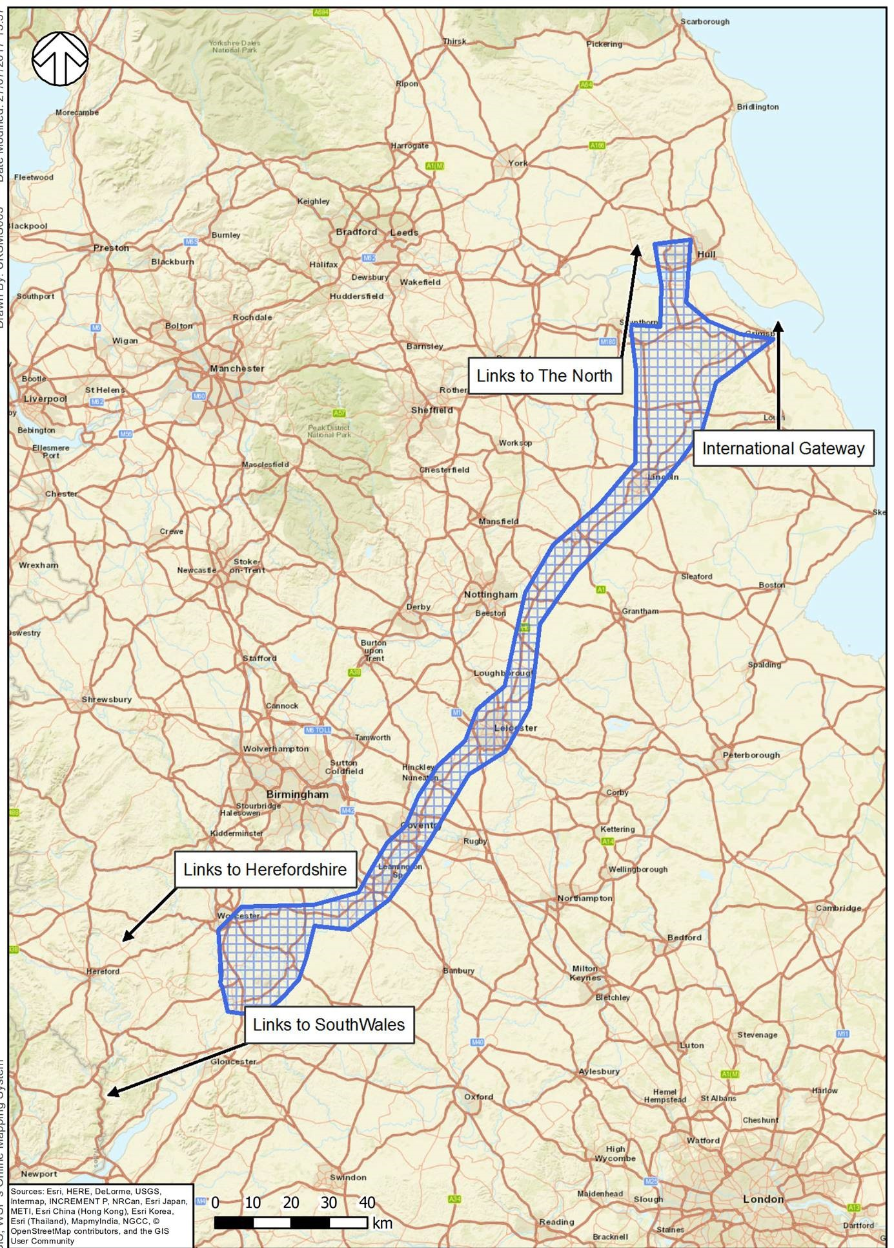
A46 Corridor Study
Strategic Study to examine the route from the M5 to the Lincolnshire Coast.
Authorities contributing and working together.
Seeking to understand how the corridor can perform local and regional functions.

Slide 23
Major Road Network Study
Starting with the work undertaken by the Rees Jeffreys foundation, MC intend to define:
What a Midlands MRN might look like
What criteria will define an MRN
The role of an STB
Study commissioned to WSP/Mott MacDonald in August 2017
Consultation phase now underway with all partners
Study due to report in January/February 2017
This will become our EVIDENCE based approach to DfT consultation

