Slide 1
MHA+ Overview

Slide 2

Agenda
Introductions
An Overview of MHA+
Procurement Rules & Governance
Professional Services Partnerships 4 (PSP4)
Performance Management
Questions

Slide 3
Introduction to MHA+

Slide 4
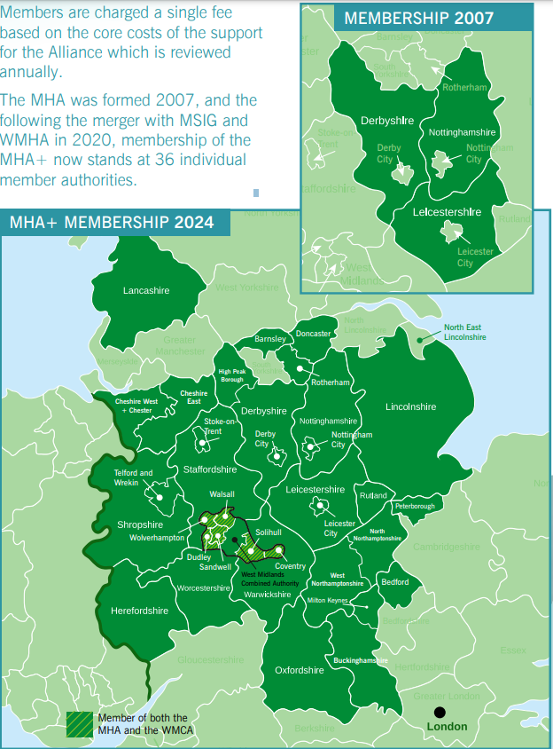
Overview
MHA+ Formed in 2020 from a merger of MHA (set up in 2007), MSIG and WMHA
36 member authorities
25% of England’s local highway authorities
Savings through collaborative procurement of frameworks
Free shared training opportunities
Collaborative working on themes and projects
Notes:
MHA+ is a unique self-funding partnership promoting excellence in the delivery of highway services, working collaboratively to support member authorities in providing effective, efficient, innovative and sustainable customer focussed highway services. It is an Unincorporated Association by Agreement = an Alliance.
It formed in 2020 from a merger of:
the Midlands Highway Alliance (MHA set up in 2007 with support from the Regional Improvement and Efficiencies Programme),
the Midlands Service Improvement Group (MSIG) and
the West Midlands Highway Alliance (WMHA)
The merger came about because of a shared Ethos of a collaborative approach working across councils to improve our highway services.
MSIG had a number specialist groups.
MHA had a number of work streams including professional services and medium schemes.
WMHA had frameworks but no long term sustainable financial support
Had joint governance meetings of MHA & MSIG for 2 years before the merger with WMHA as well in 2020.
MHA was initially 9 authorities and grew to 23 Local highway Authorities, not necessarily in Midlands, before the merger
It has now grown to 36 member authorities - a Mixture of Metropolitan districts, unitary and shire counties – 25% of England’s local highway authorities
Savings through collaborative procurement
Free shared training opportunities
Best practice network
Collaborative working on themes and projects

Slide 5
Alliance Structure
MIDLANDS HIGHWAYS ALLIANCE PLUS
36 LHAs
MEDIUM SCHEMES FRAMEWORK
PROFESSIONAL SERVICES
16 SERVICE IMPROVEMENT GROUPS
3 MHA+ THEME GROUPS
MHA+ SKILLS COMMUNITY
4 CONTRACTORS
GALLIFORD TRY
JOHN SISK & SONS
TAYLOR WOODROW INFRASTRUCTURE
BALFOUR BEATTY
2 ‘LOTS’
LOT 1 (PROFESSIONAL SERVICES)
AECOM
AMEY
LOT 2 (SECONDMENTS)
WATERMAN ASPEN
MATCHTECH
CARBON STEERING GROUP
DIGITAL WORKING GROUP
SOCIAL VALUE WORKING GROUP
WSP
Notes:
LCC is the lead authority for MHA+ and hence for procurement of the Medium Schemes & Professional Services frameworks
MSF4 is by far the largest – with an OJEU limit of £500m, but looking to exceed that within the first two years. Need to consider procuring early.
PSP3 was awarded in April 2019 –moved away from single supplier to a two lot approach – Professional Services and Secondments being separated and with two suppliers for each. Interesting dilemma – competition and collaboration.
£140m and 1304 briefs.
PSP4
The 4th MSF is by far the largest – with an OJEU limit of £1bn over 8 years.
PSP4 was awarded in August 2023 – 2 Lots. Interesting dilemma – competition and collaboration.
.
Medium Schemes Framework (MSF4) began in July 2022.
Now in 4th generation Medium Schemes framework
MSF3 delivered 100 schemes worth £389 million for 20 authorities
MSF4 in place since July 2022 for next 8 years, worth £1bn

Slide 6
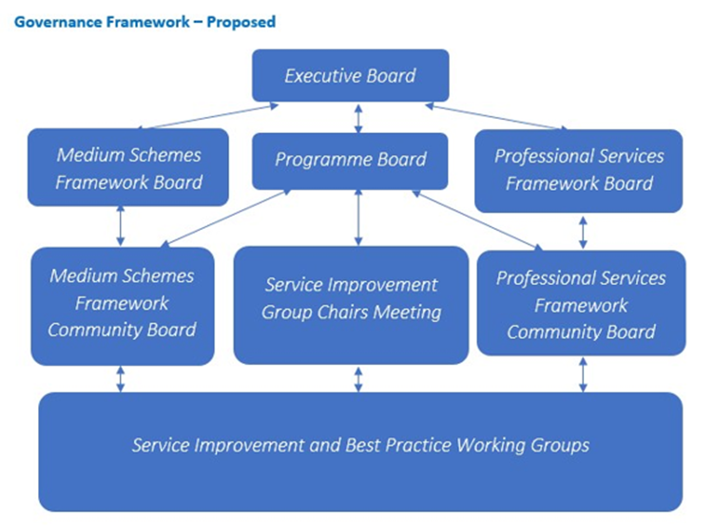
Alliance Governance

Slide 7

Aims & Objectives
Aim – to work collaboratively to support members in providing effective, efficient, innovative and sustainable customer-focused highway services
3 key objectives:
Develop and share best practice in delivering highway services
Provide effective routes to market reflecting quality, innovation and value for money
Influence the national agenda by direct participation and lobbying
Notes:
Together, we strive to:
Develop and share best practice in developing highway services
Provide effective routes to market that reflect best value, quality and innovation
Influence the national agenda by direct participation and lobbying
We are self-sustaining through a small alliance membership fee and fees for use of the frameworks
We use any reserves to invest in skills, projects to improve our services and collaborative projects
Current collaborative projects include:
Working with the Future Highways Research Group (FHRG) in supporting the Development of a Value Toolkit for Construction Schemes – trialling with 3 of our infrastructure schemes
Working with ADEPT and Colas on their Gen Z Project to develop recruitment that is dynamic

Slide 8

Governance

Slide 9
Procurement Process for Frameworks
Professional Services Find a Tender Here
Both frameworks procured under PRC2015 Regulations

Slide 10
Professional Services

Slide 11

Framework Key Facts
Professional Services Partnership 4
PSP4 began in August 2023
Worth about £960 million across 8 years
5 Suppliers split across 2 Lots
Services required for the execution of the design and supervision of highway, civil and municipal engineering works

Slide 12
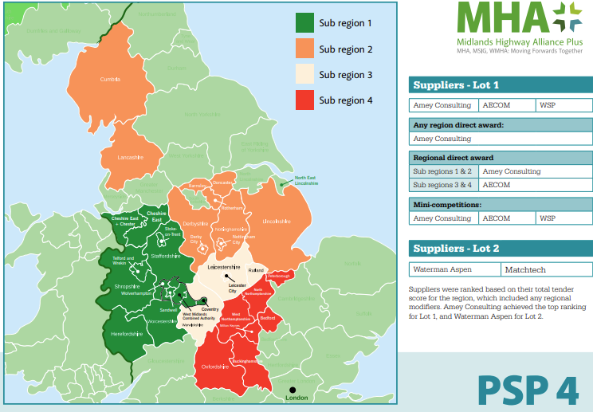
Selection Route
Sub regional call-off
- Region 1 and 2 = Amey
- Region 3 and 4 = AECOM
Direct call-off (Amey and AECOM)
- Direct Award (Default Price / Quality Weighting)
- Direct Award (Adjusted Price / Quality Weighting)
- Direct award using options above with off-shore delivery discounts
Mini-competition
- All suppliers (AECOM, Amey, WSP)

Slide 13
Main Contracts
PSC 4th Edition (NEC4) 2017 – (>£250k)
Option Clauses – Options A (Lump Sum), C (Target Cost) or E (Time-charge)
PSSC 4th Edition (NEC4) 2017 Short -
(<£250k)
Standard Secondary Option Clauses
X1,X2, [X4], [X5], [X7], [X8], X9, X10,X11, X18, Y(UK)2 and Y(UK)3
Options:
Time-charge
Lump Sum
Re-measure (New)
Z Clauses
Z1, Z2, Z3,Z4,Z5,Z6,Z7,Z8,Z9, Z10, Z11, Z12
Notes:
We have rate cards, for the PSSC options – annual uplift
Explain where the fees come in

Slide 14
Lot 1
PSC Quotation procedure
PSC Option A Priced contract with Activity Schedule.
2.3 This Option will typically be used for clearly defined Orders. The Supplier provides a quotation to provide the service required under the Order in the form of a priced activity schedule. The Prices in the schedule shall be based on the PSC Schedule of Cost Components. The MHA+ requires the Supplier to provide a detailed build up to the lump sum for each activity. The Supplier is required to link the build up of activity prices to the MHA+ PSP4 Consultant Rates used for PSSC Contracts.
PSC Option C Target Contract
2.4 The Supplier provides a quotation consisting of a schedule of activities in the same manner as Option A. However, the total of the lump sums for the activities are added together to become the Prices. The Supplier will be reimbursed Defined Costs in addition to the Fee and a pain/gain mechanism will apply at the final assessment as included in the Order.
PSC Option E Time based contract
2.5 This option will typically be used where the extent of the service required is unclear. The Supplier provides an estimate of the cost of the service as defined in the proposed Order, based on the estimated number of hours to be worked multiplied by the forecast Defined Cost of their staff. The Supplier will be reimbursed Defined Costs in addition to the Fee for their service.
PSSC Quotation procedure
This option will typically be used for low complexity services of a value up to £250,000.00.
2.10 The Supplier prepares their assessment of the total of the Prices for the Order in accordance with the requirements of the Client, utilising one of the following payment options:
    2.10.1 The service is to be carried out on a time charge basis and the Supplier’s MHA+ PSP4 Consultancy Rates for its own people and people provided by a subcontractor apply.
    2.10.2 The service is to be carried out on a priced basis.
The Supplier is paid an amount for the item, which is not adjusted if the quantity of work in the item changes. The Supplier enters the amount for each item in the Price column and enters the total of the amounts as the total of the Prices.
    2.10.3 The service is to be carried out on a re-measure basis.
The Supplier is paid according to the rate stated in the quotation for an item multiplied by the quantity completed. The Supplier inserts the rate for each item in the quotation. The entries for the item number and description, unit and expected quantity are entered by the Client / Supplier.

Slide 15
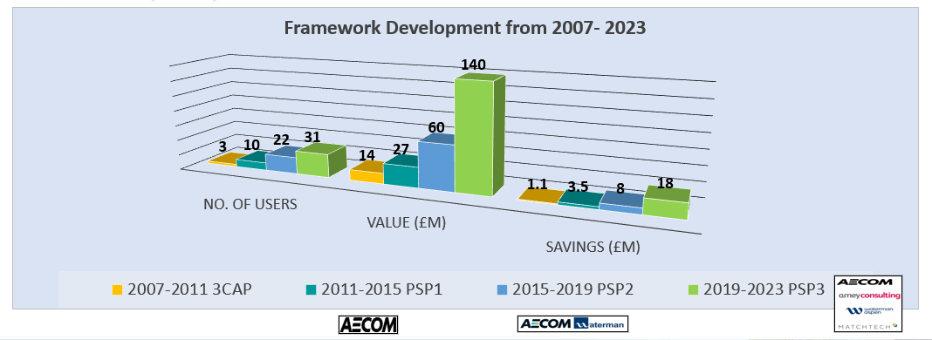
PSP Savings
We started developing the professional services framework over 20 years ago.
Starting when Nottinghamshire and Leicestershire got together with Derbyshire in 2004 to develop The Three Counties Alliance partnership (3CAP) with a professional services framework 2007-2011.
Each generation of framework has attracted more users.

Slide 16
Amey Consulting – MHA+ Ranked #1 Supplier PSP4 Lot 1
Over 100 years of transforming UK infrastructure, with origins dating back to 1921 and a long track record delivering major national projects.
A leading UK provider of full life‑cycle engineering, operations, and decarbonisation solutions across transport infrastructure and complex facilities.
Core Capabilities
Consulting & Design: Engineering design, sustainable infrastructure solutions, digital transformation, and complex programme advisory.
Advisory & Analytics: Market‑leading data science and analytics used to strengthen resilience, optimise assets, and inform client decision‑making.
Transport Infrastructure Expertise: Highways, rail, aviation, and large‑scale infrastructure upgrades, backed by decades of operational delivery.
Complex Facilities Management: Defence, justice, education, health, and public sector estates—designing, managing, and maintaining critical assets.
Carbon & Sustainability: Net‑zero advisory, decarbonisation strategies, and environmental solutions embedded across service areas.
Scale & Reach
c2000 professionals in Consulting operating throughout the UK, delivering sustainable, resilient infrastructure for national and local government clients, including many MHA+ clients.
Strong supply chain across all disciplines, including local SME’s.

Slide 17
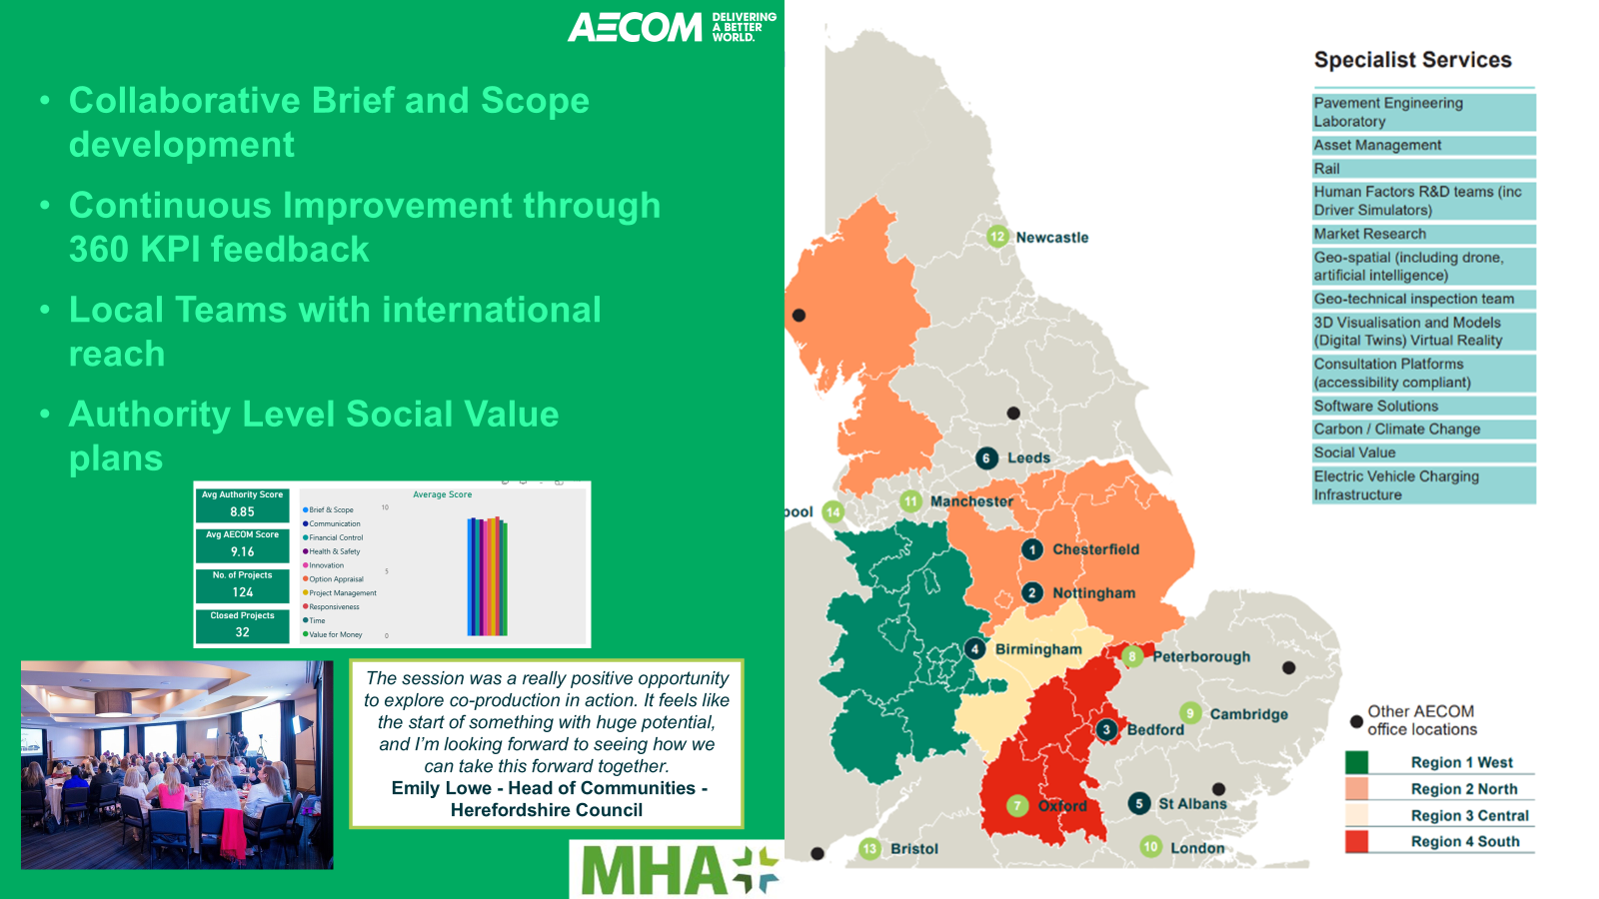
Amey Consulting – MHA+ Ranked #1 Supplier PSP4 Lot 1
Over 100 years of transforming UK infrastructure, with origins dating back to 1921 and a long track record delivering major national projects.
A leading UK provider of full life‑cycle engineering, operations, and decarbonisation solutions across transport infrastructure and complex facilities.
Core Capabilities
Consulting & Design: Engineering design, sustainable infrastructure solutions, digital transformation, and complex programme advisory.
Advisory & Analytics: Market‑leading data science and analytics used to strengthen resilience, optimise assets, and inform client decision‑making.
Transport Infrastructure Expertise: Highways, rail, aviation, and large‑scale infrastructure upgrades, backed by decades of operational delivery.
Complex Facilities Management: Defence, justice, education, health, and public sector estates—designing, managing, and maintaining critical assets.
Carbon & Sustainability: Net‑zero advisory, decarbonisation strategies, and environmental solutions embedded across service areas.
Scale & Reach
c2000 professionals in Consulting operating throughout the UK, delivering sustainable, resilient infrastructure for national and local government clients, including many MHA+ clients.
Strong supply chain across all disciplines, including local SME’s.

Slide 18
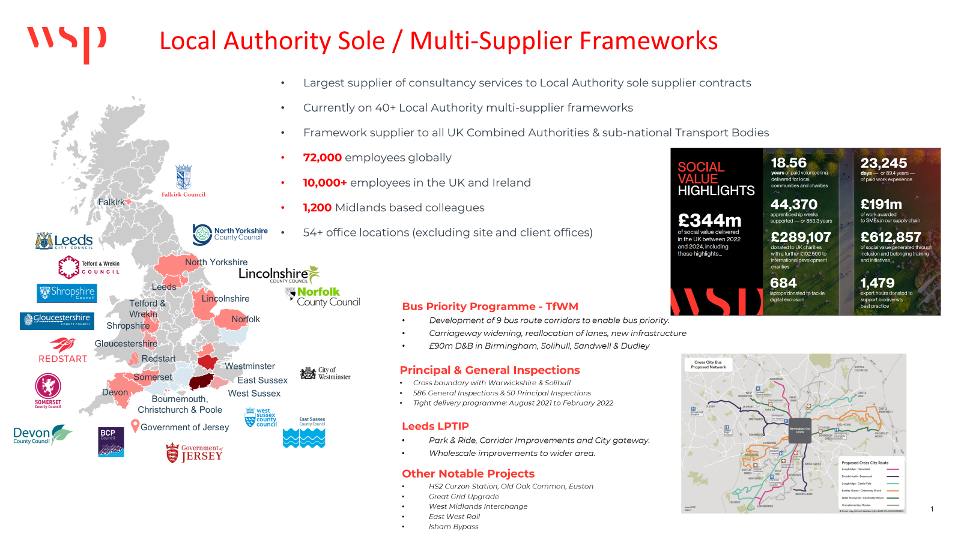

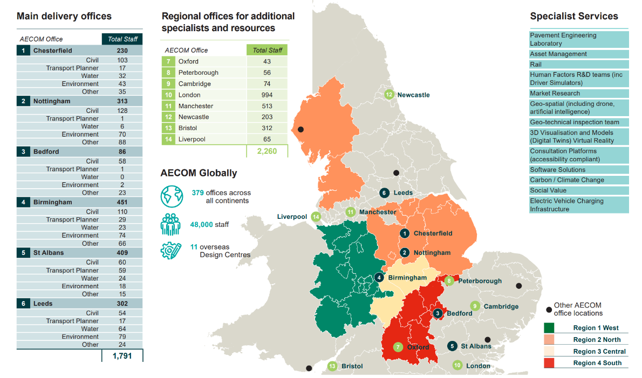
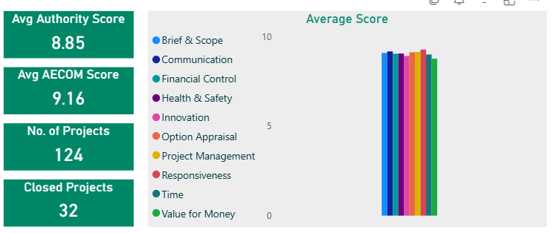


Collaborative Brief and Scope development
Continuous Improvement through 360 KPI feedback
Local Teams with international reach
Authority Level Social Value plans
The session was a really positive opportunity to explore co-production in action. It feels like the start of something with huge potential, and I’m looking forward to seeing how we can take this forward together.
Emily Lowe - Head of Communities - Herefordshire Council

Slide 19
Performance management

Slide 20
Performance Management
KPIs are collected
Reported at all board meetings
Suppliers audited throughout contract lifecycle
Notes:
Management Information and Project/Placement KPIs at least quarterly
Reporting to framework governance boards at least quarterly
Performance issues discussed at framework community board meetings
Issues escalated to MHA+ Manager/framework governance boards
Both frameworks see KPI scores showing 82-89% satisfaction
Both frameworks are developing Performance Toolkits and Dashboards
PSP suppliers allow MHA+ direct access to live performance data
Framework suppliers subject to audits

Slide 21

Benefits of the Frameworks
Faster route to procurement
Knowledge sharing
Access to technical experts through our Secondment/temporary staff routes
Collaboration across PSP and MSF
MHA+ already meet new Procurement Regs
PSP4 will operate under the 2015 procurement regulations until the frameworks are re-tendered
Notes:
Faster route – 3-4 weeks or 8-10 weeks for sub regional and mini comp
Savings – MSF3 40 million on ECI saved – MSF generally - 10% - 20% savings on project budget are typical. Median average gain 2%.
Savings >£30m through PSP
Savings >£20m through MSF ECI
Knowledge sharing – framework community boards, framework boards

Slide 22
Thank you
For more information please go to https://www.mhaplus.org.uk/

