Slide 1
Best use of technology in Cost Reduction / Productivity Enhancement in Nottinghamshire May 2025

Slide 2
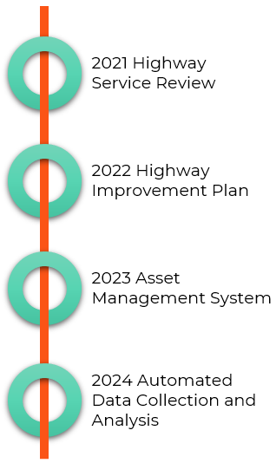
Using technology in Nottinghamshire
Nottinghamshire’s Journey
Over the last four years Nottinghamshire County Council together with it’s Teckal Company Via East Midlands have been on a transformative journey to change the way in which the Highways Service is delivered
To improve the efficiency and effectiveness of the Highways Service, numerous IT initiatives were implemented to transform maintenance management across all areas of service delivery
Having put these tools in place the journey continues…….
Notes:
Where we started from, what we needed

Slide 3
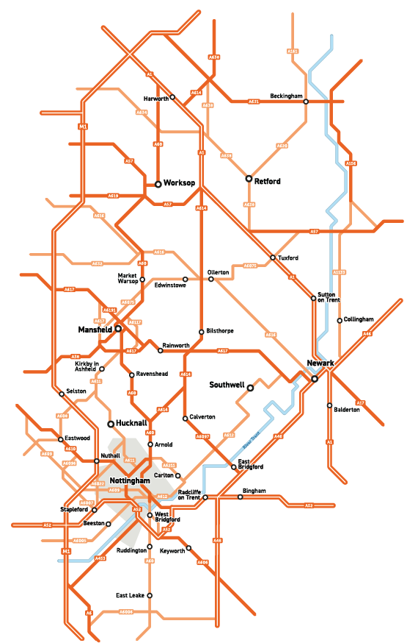
Using technology in Nottinghamshire
2021 Highway Service Review
Cross Party highways review panel set up in May 2021 to review and monitor how the Highway’s Network is maintained in Nottinghamshire
Input from
Local Government Association (LGA) peer review
External input from industry sector experts
Outputs
A comprehensive list of activities designed to improve the council’s highway maintenance work
Recommendations used to draft a new Highways Improvement Plan for the County
Notes:
A high level of member and public interest in the highways service
The Council and individual Councillors receive more queries about highways matters than any other area of the Council’s work
The Highways Service receives significant levels of investment aligned to the vital role the highway network fulfils; this makes it important that the network is maintained and managed in a cost effective and efficient way

Slide 4
Using technology in Nottinghamshire
2022 Highways Improvement Plan
Refresh and update AM Policy & Strategy
Refresh and update AM Plan
Develop and implement a formal “cross asset” prioritisation process
Optimise the application of in-situ recycling on capital maintenance works
Better use of data and evidence for highway maintenance
Investment in early intervention and treatments to extend the sustainable and effective life of the highway
Ensure that the revenue highways maintenance programme is better driven by data and evidence, e.g., use of insurance data, new technology and Realtime highway survey data
Notes:
Highways Improvement Plan focused on Specific Outcomes and activities to provide an opportunity to
reduce the need to use reactive short-term maintenance
publish a longer-term programme of capital works to keep residents informed of future plans
maintain the road network condition and seek to improve it within financial constraints
prioritise local roads and footways
engage more effectively with residents and local communities
increase our effectiveness and efficiency, maximising return on investment by ensuring that our highways maintenance and management works are driven by our policies and strategy

Slide 5
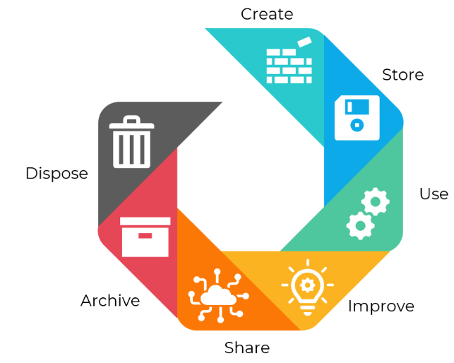
Using technology in Nottinghamshire
2023 Asset Management System
Bring in a replacement asset management system that was
Accessible and usable
Practical for all highway assets and Inspections
Able to manage customer enquiries, reports and responses
Has all relevant data together in one place
Able to integrate with other systems and sources of data
Provide consistent accurate data and information
Capture concurrent data and information from bespoke asset systems such as BridgeStation and IMTRAC
Improves reporting functionality, linked to a Dashboard
Notes:
First and foremost a new asset management system was required, the existing system was not suitable for all assets, it had limited use by teams and was difficult to mange requiring specialist knowledge
Many systems were reviewed
In April 2023, Via went live with the Alloy Asset Management System
Thousands of assets, including carriageways, footways, streetlights, drainage, and structures, are stored in Alloy
Alloy manages the county council's highway inspection regime, a risk-based approach derived from the carriageway and footway hierarchies
One version of the truth, accessible to all

Slide 6
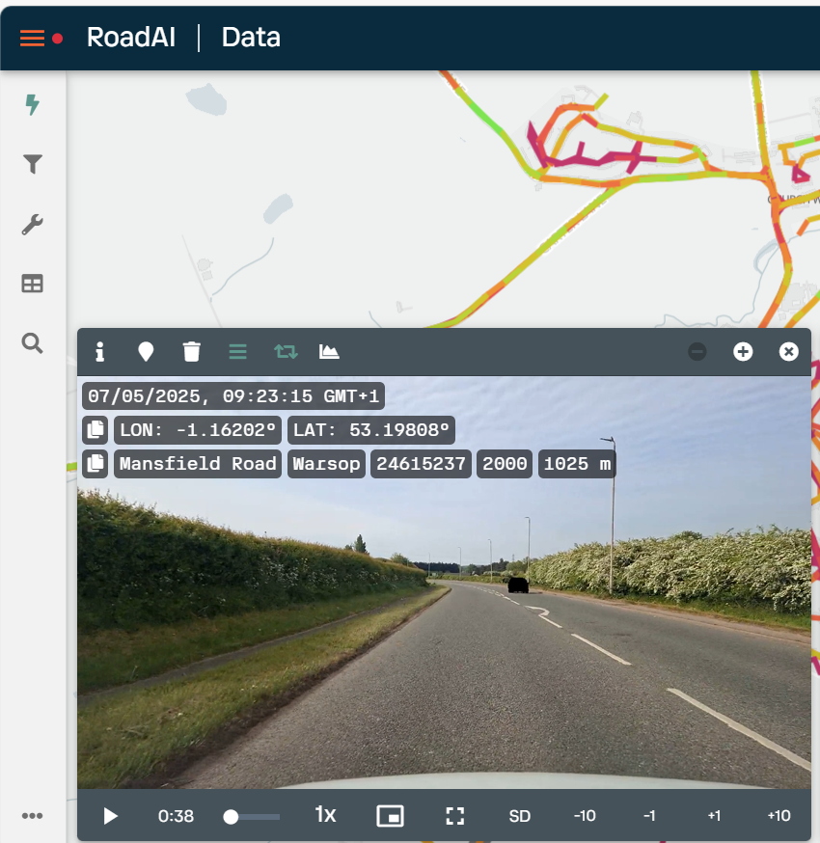
Using technology in Nottinghamshire
2024 Automated Data Collection
Video data capture devices in all Highway Inspection vehicles
Continuous collection of data
Real-time updates
Dynamic Condition Monitoring
Future Improvements, data collection for
Road Lining / Road Marking
Traffic Signs
Surface Water
Notes:
Following a trial, and having previously tried other data collection techniques in November 2024 Via went live with the Vaisala Road AI system,
Vaisala Road AI was installed inside Highway Inspectors’ vehicles
Therefore continuous “live” data is being captured, and refreshed, as frequently as the inspections are conducted, in accordance with our risk-based approach
Supplies condition reporting in line with PAS 2161 data standard requirements

Slide 7
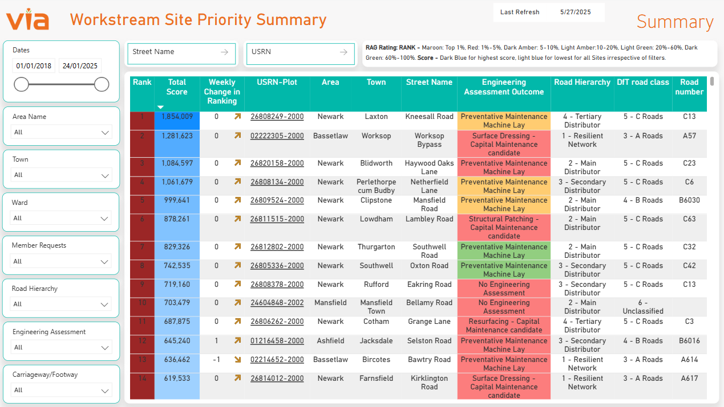
Using technology in Nottinghamshire
2024 Automated Data Analysis
Site Priority Summary (SiPS)
Produce a ranked list of carriageway sites, based on
Defects
Claims
Customer Enquires
Member Requests
Engineering Assessments for forward programme inclusion
Future Improvements
SiPS for all asset groups
Notes:
SiPS (Site Priority Summary) developed so that we could understand the needs of our carriageway and footway network, the condition it was in, together where we were getting the most enquires and claims
SiPS takes condition data from Vaisala, customer / member enquiries and claims data to produces a prioritised list of sites for further investigation
The data always remains live as the flow of inputs is continuous
This methodology allows for the dynamic condition monitoring of the highway network in real-time
The prioritised list of sites in SiPS is assessed by Via’s Engineers to decide on the most appropriate treatment and include them in forward works programmes
Using SiPS helps us to formulate our forward programme, so that should additional funding become available we are able to proactively bring in assets with the most need and have the highest risk
We plan to develop SiPS further for other asset types, so that each asset type has its own objective works prioritisation system from which we can develop life cycle plans
Drainage SiPS is almost complete

Slide 8
Using technology in Nottinghamshire
Using the Technology
Customer Enquires
Insurance Claims
Power BI
Site Priority Summary (SiPS)
Defect data
Condition
Inspection Reports
API
Reporting via
The Highways Hub
Outputs
Capital Maintenance Programme
Life Cycle Plans
Cross Asset Allocation
Notes:
How the technology is used and how it interacts
The automation of data collection and analysis, provides a seamless workflow that reduces errors, improves productivity, and allows for more to be achieved with the same resources
Alloy is central to our work – one version of the truth
From inspector to forward programme to delivery on site
Improves decision making
Prioritises funding based on need
Transforms maintenance management

Slide 9
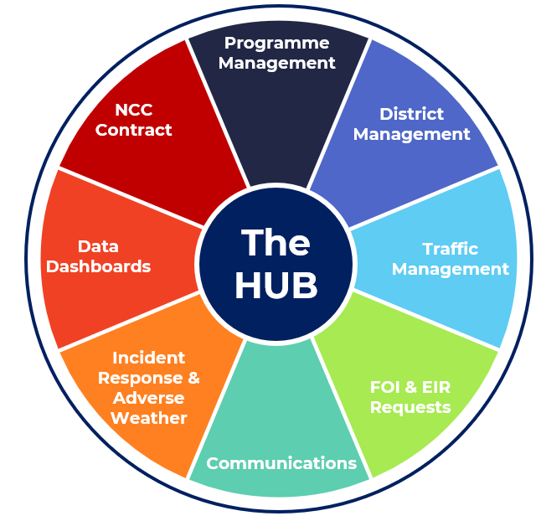
Using technology in Nottinghamshire
The Highways Hub
Enhanced Efficiency: Centralised planning and coordination, streamlined delivery of maintenance activities across the county
Better Communication: Residents, businesses, and road users receive clearer and more timely updates about upcoming and ongoing works, helping them prepare and stay informed
Reduced Disruption: whole-street approach means multiple repairs are coordinated under a single traffic management system, minimising the frequency of road closures
Cost-Effectiveness: Centralised coordination improved value for money through a more efficient and organised process
Notes:
The Highways Hub is the one point of contact between Via and Nottinghamshire County Council, it ensures that communication flows efficiently and effectively – that the right people are aware
It provides
Better support communication and engagement with residents
Better information for councillors related to highways activity in their wards
Closer links with community influencers such as parish councils, to ensure that communities are better informed about local works
Updates and refreshes scheme information/signage to better inform residents of highways works

Slide 10
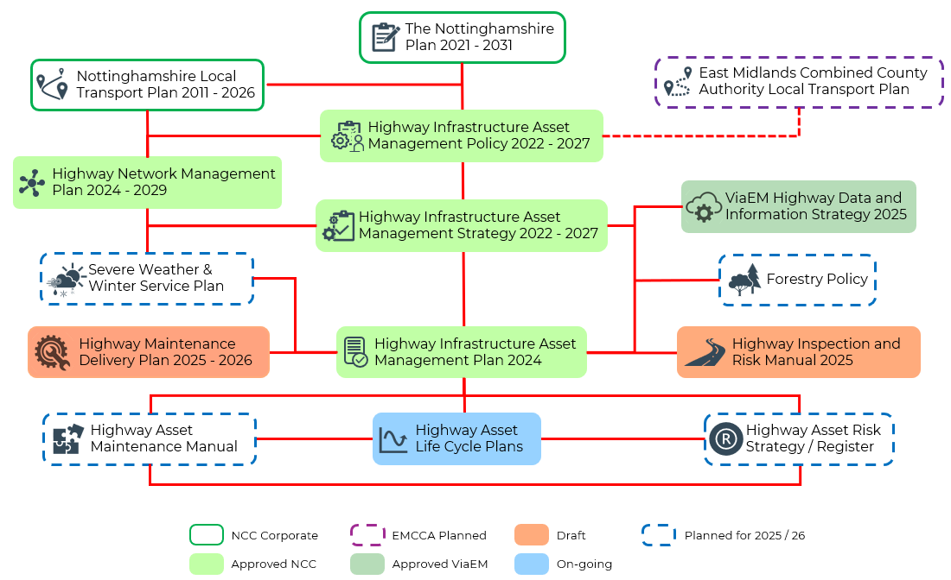
Using technology in Nottinghamshire
Asset Management Framework
Notes:
The Highways Improvement Plan was not only about using technology but ensuring that we have in place an Asset Management Framework, where our key documents are developed, maintained and managed for everyone to use and have access to

Slide 11
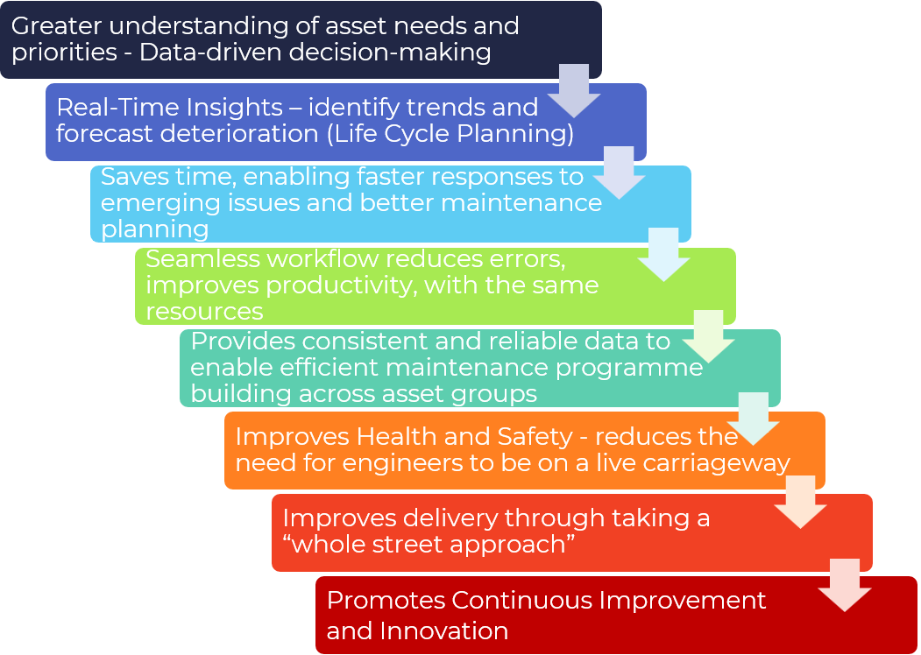
Using technology in Nottinghamshire
Benefits and Efficiencies
Notes:
The Highways Improvement Plan has been a driver for change within both Nottinghamshire and Via
Having undertaken this work, we are beginning to realise tangible benefits so that we are able to deliver a more efficient and effective Highways Maintenance Programme

Slide 12
Using technology in Nottinghamshire
Next Steps
Using data outputs for Cross Asset Allocation and Life Cycle Planning to support decisions
Continue use of technology to ensure responsive maintenance service
Investigate innovative techniques
Development of a Highway Service Customer Strategy
Supporting newly elected members to understand the balance of funding against the needs of assets
Positioning Nottinghamshire and Via EM for success through a changing political landscape and the reorganisation of Local Government
Notes:
There is still work to be done, we are part way through our journey, we will continue to harness the benefits of adopting and developing technology

Slide 13
Using technology in Nottinghamshire
Thank - you

