Slide 1
Wednesday 13 October 2021
Break Out Session: Measuring Net Zero
Chair: Chris Green, Leicestershire CC
Speaker/Facilitator: Eoin Harris, Aecom

Slide 2
Agenda / Objectives
Overview of the Green House Gas Protocol and Net Zero.
Measuring Carbon in Capital Projects (Scope 3)
Organizational readiness
Challenges
Baseline data
Enablers

Slide 3
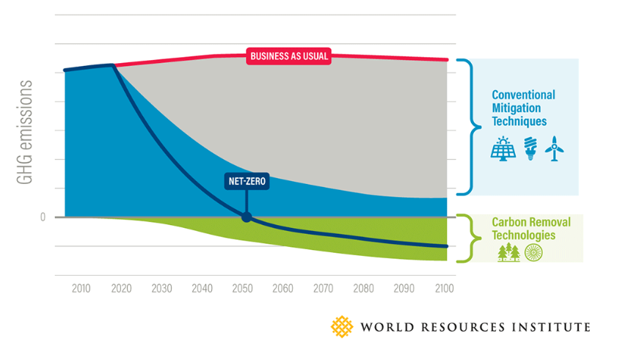
Net Zero
The balance of human generated greenhouse gas emissions and removals. The process should focus on ‘absolute reductions’ prior to carbon removal / offsets.

Slide 4
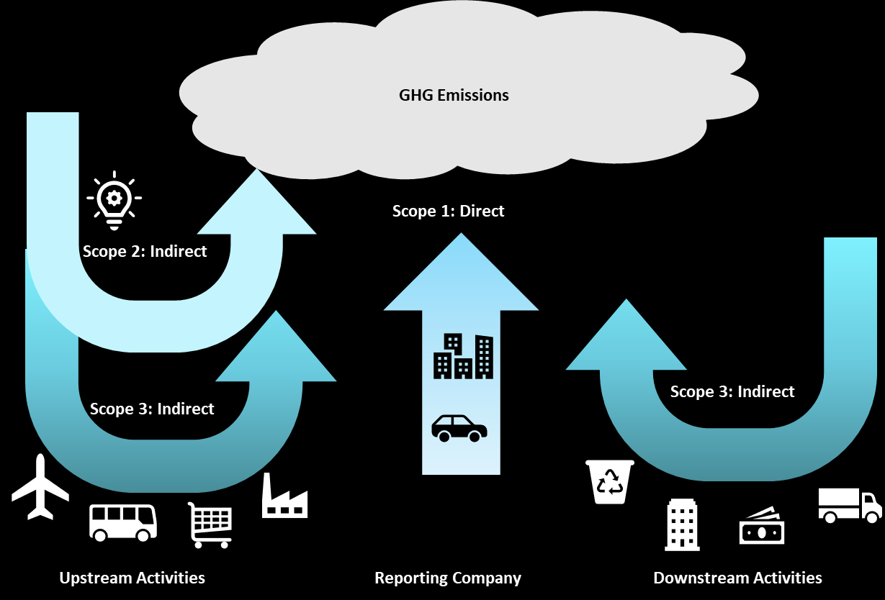

Slide 5
What are your carbon/GHG emissions?
Which emissions can you control vs. influence?
Your carbon footprint includes emissions in direct control (scope 1 and 2) and those which can be influenced (scope 3)
Do you know your carbon footprint?
Understanding your emissions and from which activities enables focus on reduction opportunities
The starting point on the journey to Net Zero, for any organisation, is to establish its carbon footprint

Slide 6
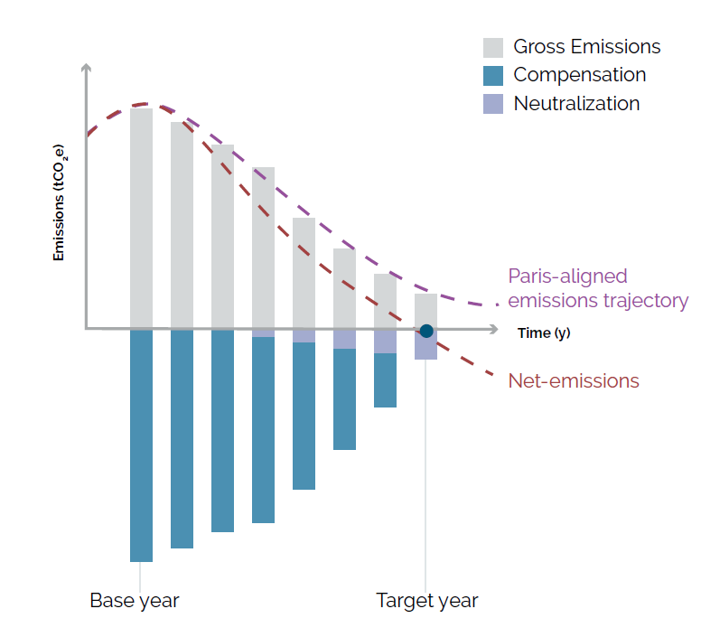
Target Setting
Set reduction targets aligned to Paris Agreement
Guidance for different sectors
Ambition: WB2C, 1.5C, Net Zero
Timeframes: 5-15 years
Boundaries: Scope 3 must be included if >40% of carbon footprint

Slide 7
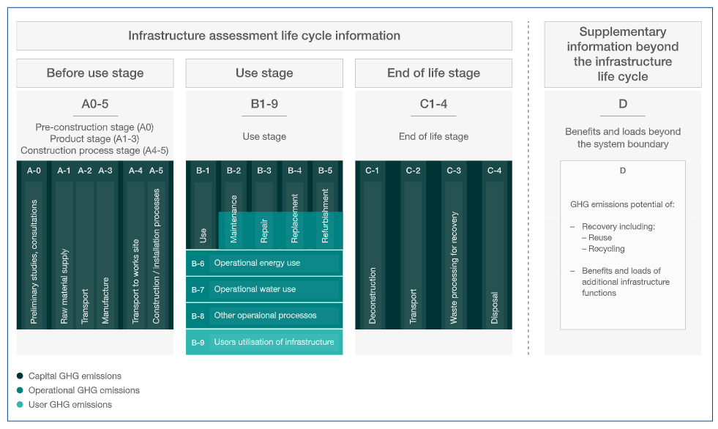
Notes:
PAS 2080 provides a methodical, best practice approach for calculating whole life carbon across a project’s delivery
A modular approach (A, B, C, D), which combined contribute to a project’s whole life cycle.
Each of these modules is further broken down into specific areas of the projects which have the potential to contribute to carbon emissions.
Beyond carbon reporting PAS2080 provides mechanism for target setting, carbon management and continual improvement.

Slide 8
Open Floor
Where are you on your journey to Net Zero?
How ready are you to start on this journey?
What are the key challenges that lay ahead?
Do you have your baseline data?
What are the enablers for you to do this?

Slide 9
Workshop Outcomes/ Discussion (1 of 2)
Concerns about double counting on scope 3 materials carbon footprints. Answer was that this data needs to be properly tagged and consistent (e.g. through PAS2080) and then can be cleansed later (Action: EH to double check this)
Comment that need to have carbon shadow pricing per tonne in embodied material/ project costs
How many CEOs balance cost and carbon? How is this translated through to senior management/ project budgets
Mention of the use of Qflow(£) – automatic software for monitoring. Includes QR codes for material and waste dockets (feeds into measuring project footprint). (I think this came from Eurovia)
Does MHA/ Clients have a carbon budget (delegate referring to £ rather than CO2) that is driven by central government that could ‘subsidise’ low carbon initiatives
ECI needs to drive low carbon agenda and discussions (refers to JS and EH presentations about reducing carbon early in the process)
MHA Schemes need to have unified carbon (and sustainability) KPIs to avoid duplications and costs of data collection and reporting
Ownership – need to be engineers with the support of sustainability specialists (EH comment that there are lots of strong graduates from all fields with this knowledge coming through)

Slide 10
Workshop Outcomes/ Discussion (2 of 2)
Representative from MK – need to get buy in from cabinet members/ incumbent parties and secure through contract procurement
Need to have a standard set of MHA targets and aspirations that are embedded in all organisations and adopted in early project development/ business case
Maybe we need a carbon QS that monitors carbon through design and construction
Outcomes approach vs the current specifications-led approach
Change management – maybe its time to just say we are going to do it and appropriately manage the communications as we go.
Need to share best practice, experiences and standardised MHA tools
Carbon focus group that needs to set the way forward and vision, but building from existing tools and ambitions, not creating new ones

