Slide 1
Midland Service Improvement Group
Highway Maintenance and Asset Management Task group

Slide 2
Incentivised Funding
DfT Self-Assessment 16/17 – 20/21
Level 2 – 16/17
Level 3 – 17/18
Communications
Lifecycle Planning
Resilient Networks

Slide 3
Level 2 / Level 3
Communications Strategies
Pitching the Message
Lifecycle Planning Framework Document – December 2017
Hierarchy Review
Resilient Network
Member Documents and Presentations
Cross Authority Network Border Points

Slide 4
Code of Practice
Well Maintained Highway Infrastructure – October 2016
Risk Based Approach
Light Touch Peer Reviews
Identify Areas of Weakness
MHA/MSIG Workshop – July 2017
Risk Based Workshop – March 2018
High Level Principles Approach to Safety Inspections and Response Times 2016, Revised 2018

Slide 5
Risk Based Approach
Competent RBA Safety Inspectors
RBA Safety Inspector Training
National Certificated Training by Accredited Training Organisations
Submitted Research Proposal through the UKRLG Asset Management Board
Develop a Framework from which training organisations can develop and run certificated training for both dimension and dimensionless policies

Slide 6
Dimensionless RBA Policy
‘Anything that a reasonable person can see and would recognise as a defect in the highway asset when travelling via the mode being used by the highway inspector at the time of inspection’

Slide 7
Dimensionless RBA Policy

Slide 8
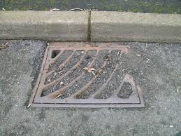
Industry Presentations
Pavement Recycling
Gully Management Systems
Pavement Management Systems
Patching Materials and Systems
Specialist Surfacing Materials and Systems
Crack Sealing
Lining
Claim Defence Solicitor

Slide 9
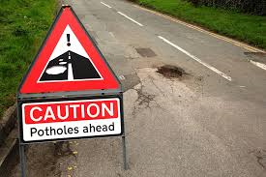
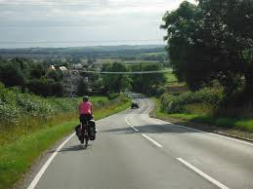
Consultations
Major Roads Network
Transport Select Committee Inquiry into the Funding and Governance of Local Roads in England

Slide 10
Discussion Board
Pavement Management Systems
Asset Management Tools (Software)
Preventative Surfacing Guarantee Periods
Performance Frameworks
Skid Resistance Policies
Vehicle Access Crossings
Safety Inspector Outputs (New CoP)
Gully Emptying Outputs

Slide 11
Efficiencies / Improvements
Over 240 examples of Efficiencies and Improvements
Collaborative Policy Development
Collaborative Training
Incentive Funding
Light Touch Peer Reviews
Structures Issues Design Fixes
Use of Low Temperature asphalts
Material Spec and Asphalt Paving

Slide 12
MSIG / MHA – Working as One

Slide 13
Thank you paul.boss@staffordshire.gov.uk paul.boss@amey.co.uk

