Slide 1

Martin Tugwell
Programme Director
11 September 2018
www.englandseconomicheartland.com

Slide 2

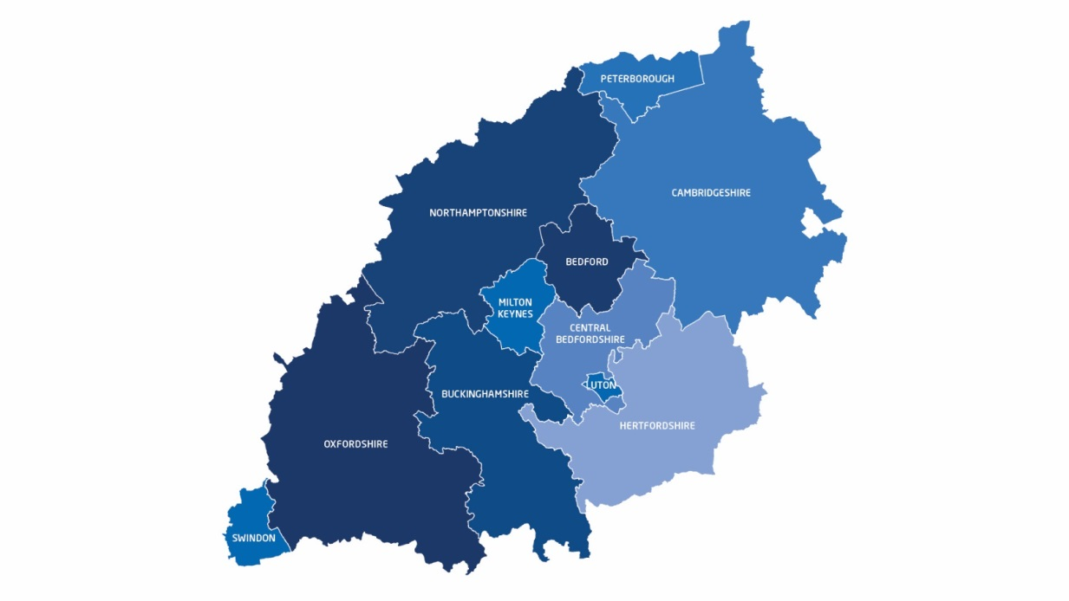

Delivering through Strategic Collaborative Partnership
Founded Autumn 2014 – To realise the Heartland’s economic potential
A growing movement of liked minded individuals/organisations committed to realising that ambition
Swindon Borough Council
Hertfordshire County Council
Greater Cambridgeshire and Peterborough Combined Authority
District Council Leaders
www.englandseconomicheartland.com

Slide 3

A Region of Economic Success….
www.englandseconomicheartland.com

Slide 4
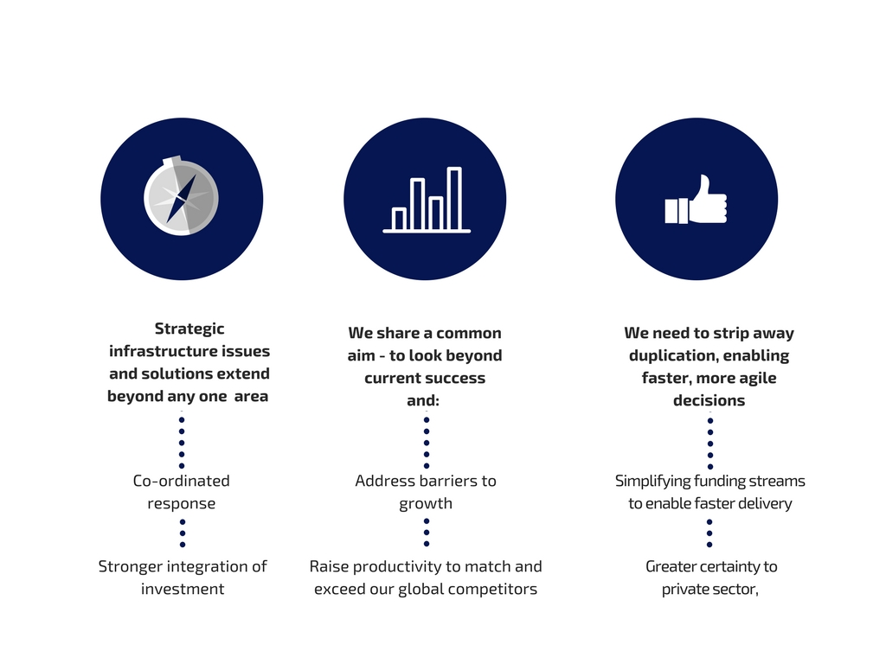
Adding value through strategic leadership
www.englandseconomicheartland.com

Slide 5


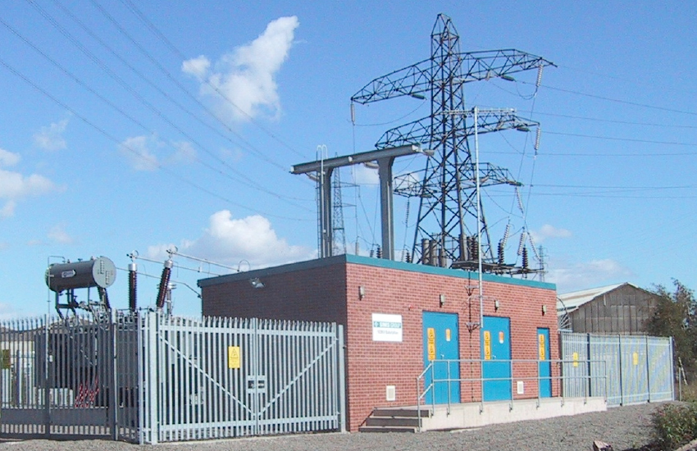

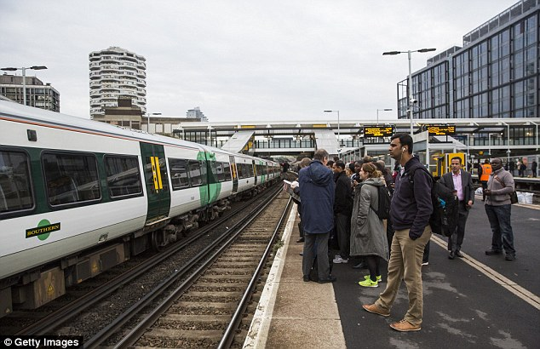
… but with infrastructure under pressure
www.englandseconomicheartland.com

Slide 6

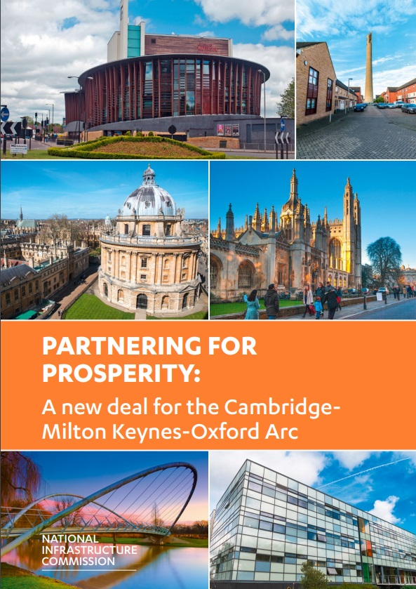
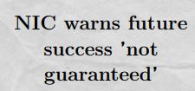
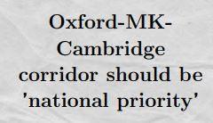
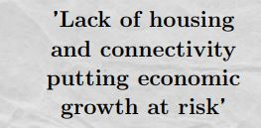
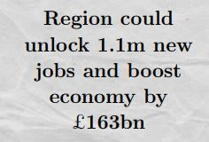

A region with economic potential to be realised
www.englandseconomicheartland.com

Slide 7

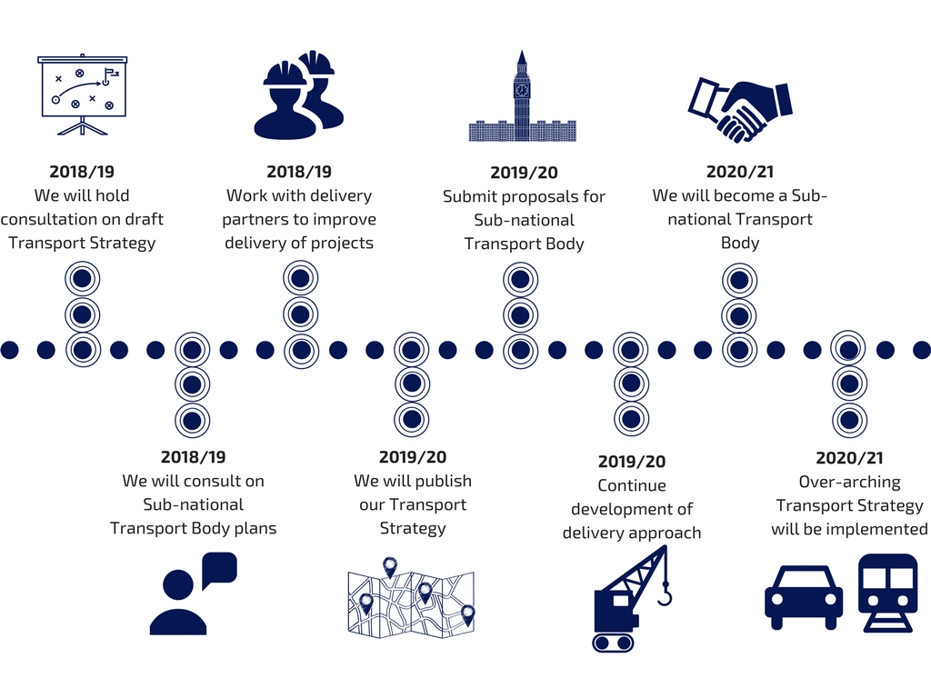
A three-year Programme of Work
www.englandseconomicheartland.com

Slide 8
Opportunities - 1
England’s Economic Heartland…
  providing strategic leadership based on collaborative partnership
National Policy Statement…
  A long-term commitment by Government at the national level – one that extends beyond a single electoral cycle
  A strengthened framework within which the need for strategic infrastructure investment can be established
  A stronger framework within which independent regulators for utility providers plan for and deliver investment
  A strengthened framework within which permission for strategic infrastructure is determined
  Adopting a programme approach to strategic infrastructure delivery that is better co-ordinated and more cost effective
www.englandseconomicheartland.com

Slide 9
Opportunities - 2
Regional Evidence Base comprising …
  The ‘database’ – brings together information on planned growth (housing and economic), socio-economic data and transport information.
  The ‘datahub’ – preferred option for this identified: will have the added value of supporting the development of the ‘eco-system’ that encourages innovation across the Heartland
  The Policy Scenario Model – proof of concept commissioned available mid-Summer
Scenario Planning…
  Use this to create a framework, a direction of travel along which we then travel
A new partnership with the private sector…
  … in the broadest sense: it must not be just about houses
www.englandseconomicheartland.com

Slide 10






Collaborative Working with our ‘Delivery Partners’
www.englandseconomicheartland.com

Slide 11

Heartland and Government – time for a Grand Bargain
Our shared economic potential cannot be realised without a step change in investment
Budget 2018: the next step
Government work with us to put in place a National Policy Statement for the region
Establish a ‘major scheme development fund’ that will develop proposals for the investment pipeline
An ‘indicative funding envelope’ for the region –an honest conversation about the investment choices we have to make
Establishing a Joint Delivery Unit – one that brings Heartland and Government together
Ensure that six key infrastructure projects continue to be given priority in the year ahead.
www.englandseconomicheartland.com

Slide 12



@EconomicHeart
Search ‘England’s Economic Heartland
www.englandseconomicheartland.com
Subscribe to our newsletter

