Slide 1








Transport Infrastructure Skills Strategy
One year on
Catherine De Marco
Notes:
I’m down to talk to you about the baseline study.
What I’m going to talk to you about is how we’ve used NSAR’s skills intelligence model frame our thinking in the STAT – the Strategic Transport Apprenticeship Taskforce
And how we captured that in our “one year on report” published yesterday
[Help yourselves to copies]

Slide 2
Outline of this presentation
The Transport Infrastructure Skills Strategy, 2016
The One year on report, 2017
  Meeting the demand for skilled people
  Developing the right quality skills
  Securing our future skills
Next Steps

Slide 3
The challenge – why does transport need a skills strategy?
Delivering the unprecedented investment in transport
Ageing workforce
Lack of diversity
Increased demand for higher technical skills
Inconsistent incentives through procurement.
Poor perceptions of transport as a career, particularly for women and BAME.
Critical skills shortage
Low productivity
Rising wage inflation

Slide 4

Quick recap – what is the TISS?
The Transport Skills Strategy published in Jan 2016 set out how government and industry will:
Address skills underinvestment through delivering 30,000 apprenticeships over the 5 years to 2020 by linking transport infrastructure procurement with skills.
Address the skills gap through increasing the number of higher apprenticeships, increasing the talent pool through a diverse workforce and upskilling the existing workforce.
Transport sector to work as single voice in maximising opportunities to achieve a shared agenda.
Make best use of world-class transport teaching and training facilities which work with each other to identify future skills needs.
Establish a home-grown transport skills legacy- through strategic work with schools to promote transport as a career of choice
The TISS established the Strategic Transport Apprenticeship Taskforce to deliver its ambitions

Slide 5

And we are gathering momentum – from our original partners…..

Slide 6
To the STAT partners…..

Slide 7
The maritime and logistics sectors have now also joined. And so one year on, this is the picture…

Slide 8
Notes:
First a snapshot of what we’ve done.
So first take away is – STAT is working right across the modes – look at the size of the opportunity.
What NSAR’s model has given us is [this] – the range of apprenticeship number s we need in roads and rail over a planning horizon to 2022.
So this is a really intelligent look at the needs by discipline, by region.
And the reason I’m so excited about the model is that it has the functionality to be used for other modes too.
This is a really great example of where rail is ahead of the game, and can share its learning with other parts of the sector

Slide 9
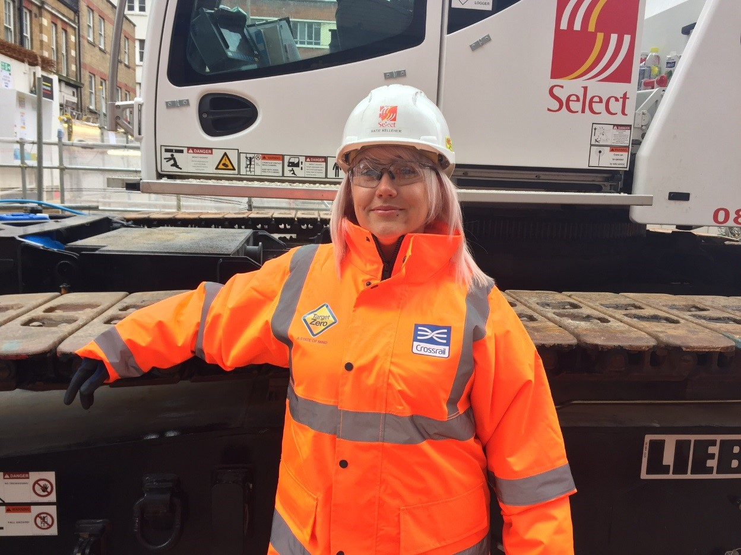
Meeting the demand for skilled people
The scale of the need

Slide 10
The scale of the need: Apprenticeship starts by year by organisation – modelled – Road and Rail
Notes:
I’m really proud of how open and transparent we’ve been in setting out these numbers.
These are the modelled numbers by organisation.
Rail’s share is around 86% - so 23k – 30k to 2022
There’s a steep trajectory from this year’s actuals
The first year the skills requirements have appeared in contracts across the board – so ITTs from April, contracts move to award
As organisations are gearing up for the levy
You’ll see the shape of this curve is not atypical

Slide 11
Scale of the need: 2022 Forecasted skill levels Road and Rail
Notes:
In rail, we will need 10% higher level skills over time.
Particularly the levels 3 and 4
Contrast with the roads sector, where the operative level continues to be more important

Slide 12
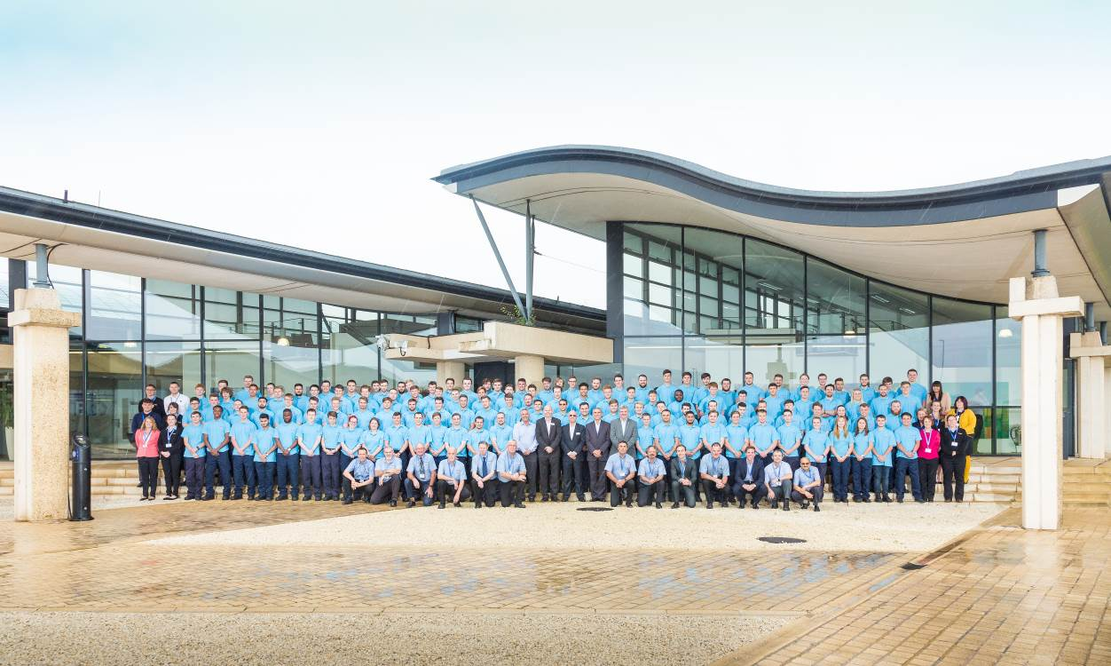
Meeting the demand for skilled people
Driving investment

Slide 13
Business Planning
Actual and forecast apprentice starts across the roads and rail sector 2016-2022
Notes:
So this is bottom up business planning across the organsiations

Slide 14
Actual numbers compared to 2016/17 forecast: First year of reporting we were able to achieve a 23% increase in forecasted supply chain apprenticeship starts
Notes:
Supply chain forecasts – 1200 – actually better performace

Slide 15

Meeting the demand for skilled people
Greater workforce diversity and inclusion

Slide 16
We are encouraged by the fact that 39% of starts at the highest NVQ levels are female
Notes:
Actual starts – looking back to chart on slide 4 – we’re not a million miles away

Slide 17
Characteristics of the Rail Workforce – age and gender
12%
88%
2013, 8%
Notes:
12% women in the rail sector. A slow improvement on 8% in 2013. Still pretty poor but we don’t have this data for the other sectors so we don’t know how it compares

Slide 18
Diversity of Apprenticeship starts
Notes:
Apprenticeship starts slightly higher, still not great.
In technical and engineering apprenticeships these figures are 12% for supply chain, 9% organisations.
The problem we have with BAME is lack of reporting

Slide 19












STAT Gender diversity leadership group

Slide 20
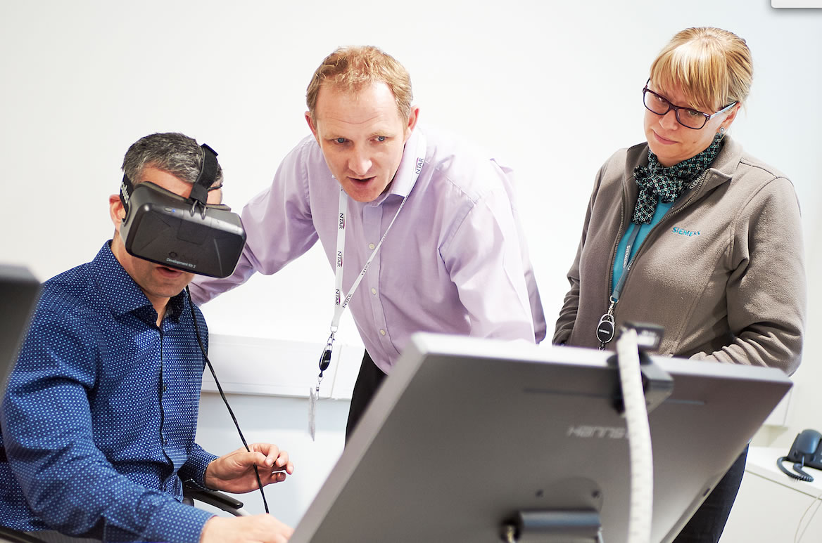
Developing the right quality skills

Slide 21

Developing the right quality skills
  Research with Investors in People to provide the basis for an innovative, robust and measurable standard for apprentice employers
    Employer motivations and how these reflect the quality of placements
    Overall encouraging, but there are also poor perceptions and lack of knowledge about apprenticeships among employers
    Key features of a quality apprentice employer are:
      Commitment to training and development
      Diverse approach
      Consistent and dedicated support
      Clear progression routes
      Good relationship with training provider
      Strongly motivated to take on apprentices for business and individual growth
Notes:
Higher level skills will be more costly for employers, and will require a commitment to investing in people. Quality of training provision, standard and working environment needs to be high to ensure a positive return on investment

Slide 22
Strong and positive response to the quality imperative right across the sector…
  Large numbers of standards approved or in development
  Rail Sector Skills Delivery Plan
  Highways England Skills Plan
  Heathrow Skills Taskforce
  Maritime UK

Slide 23

Securing our future skills

Slide 24
Securing our future skills
The FE and HE sectors need to be ready to meet the demand our sector we are creating in transport
  Research commissioned by STAT highlights opportunities and challenges
  Initiatives such as NSAR training alliance will ensure greater coverage, access and quality assurance
Promoting transport and logistics to young people in schools
  ~17k engineering and ~4k transport volunteers nationally through Inspire the Future and STEM Learning

Slide 25
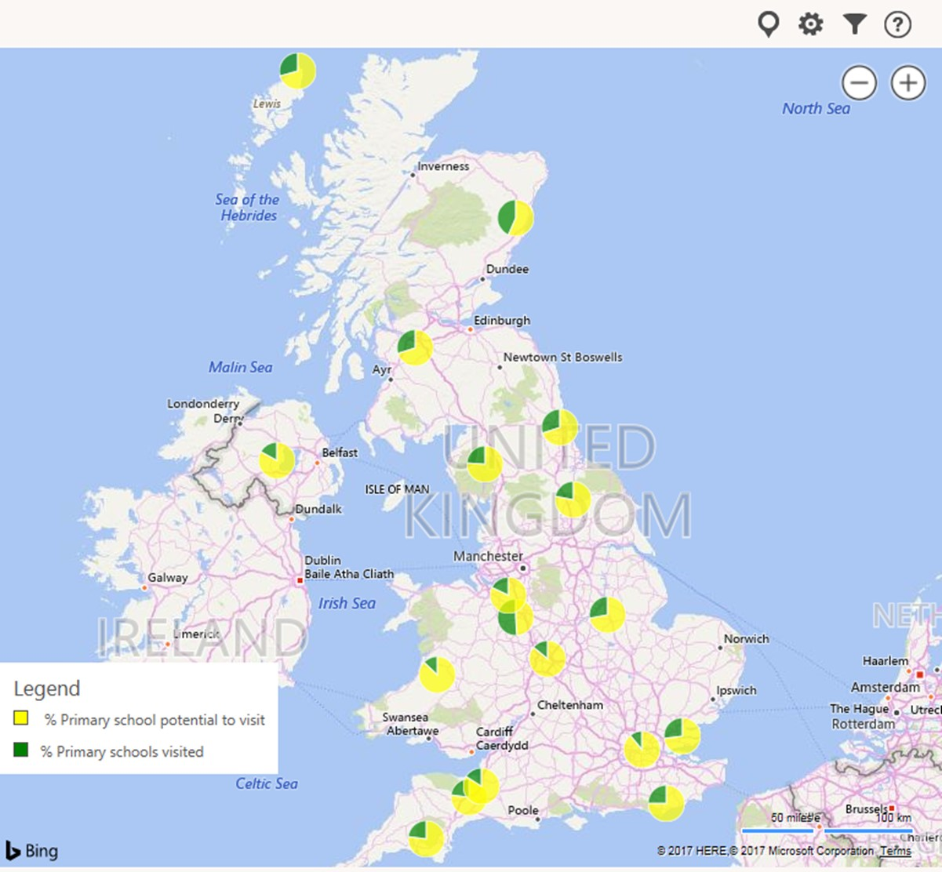
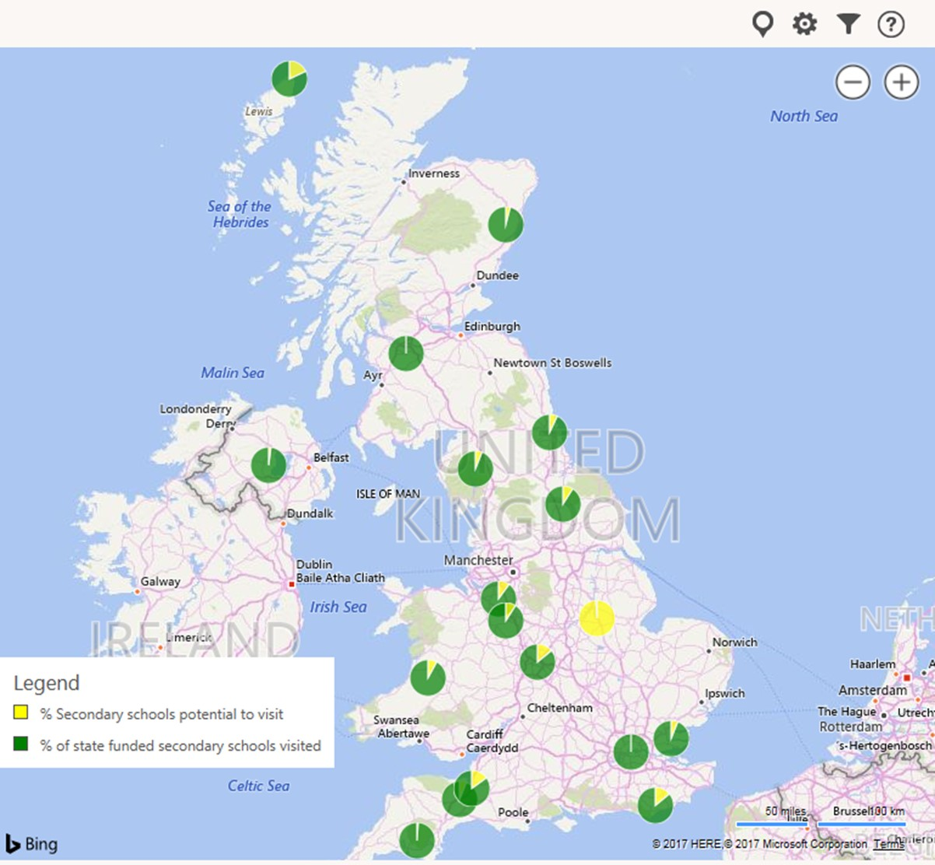
Schools volunteering mapped

Slide 26
Key priorities for year 2 include…
Year 1 was a good start, but we need to do more to drive investment in skills
Formal engagement strategy with supply chain starting imminently
Developing greater understanding of opportunities and challenges of investing in skills below Tier One
STAT will work with NSAR to update the Skills Intelligence Model to identify key skills shortages and prioritise areas of focus.
Including :
Additional survey work to inform inputs on workforce characteristics
Broadening the model to cover additional modes of transport
STAT will:
Continue to further diversity and inclusion across the sector through the diversity leadership group
Develop a programme of work aimed at enabling social mobility through the apprenticeships we create

Slide 27
Thank you. Please keep in touch
Catherine.de_marco@dft.gsi.gov.uk

